Slide 1
Kundinformation / customer information
BMW C 400 X/ C 400 GT MY19-
05/2020

Slide 2
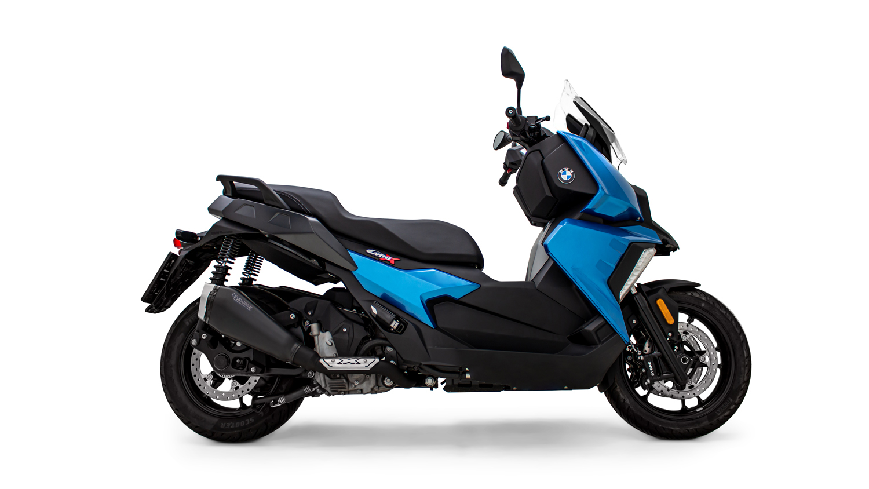
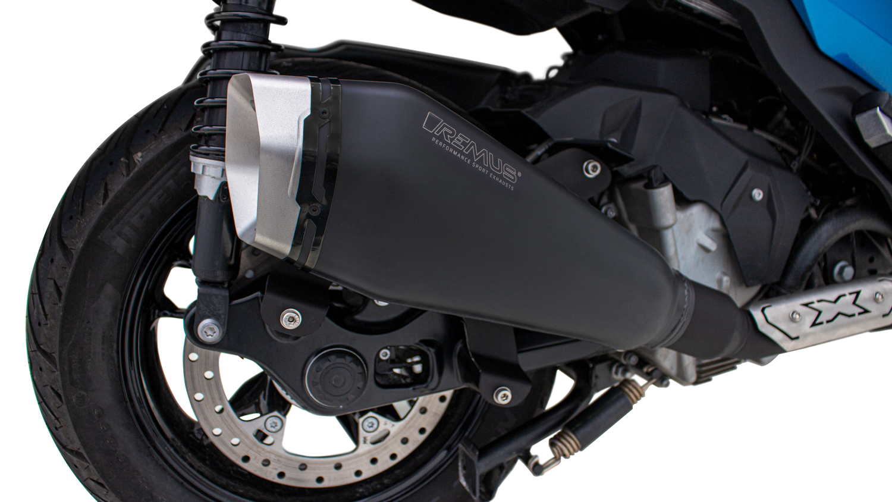
BMW C 400 X/ C 400 GT MY19-
REMUS RS Edelstahl schwarz, Endkappe: Aluminium silber / REMUS RS stainless steel black, end cap: aluminium silver

Slide 3
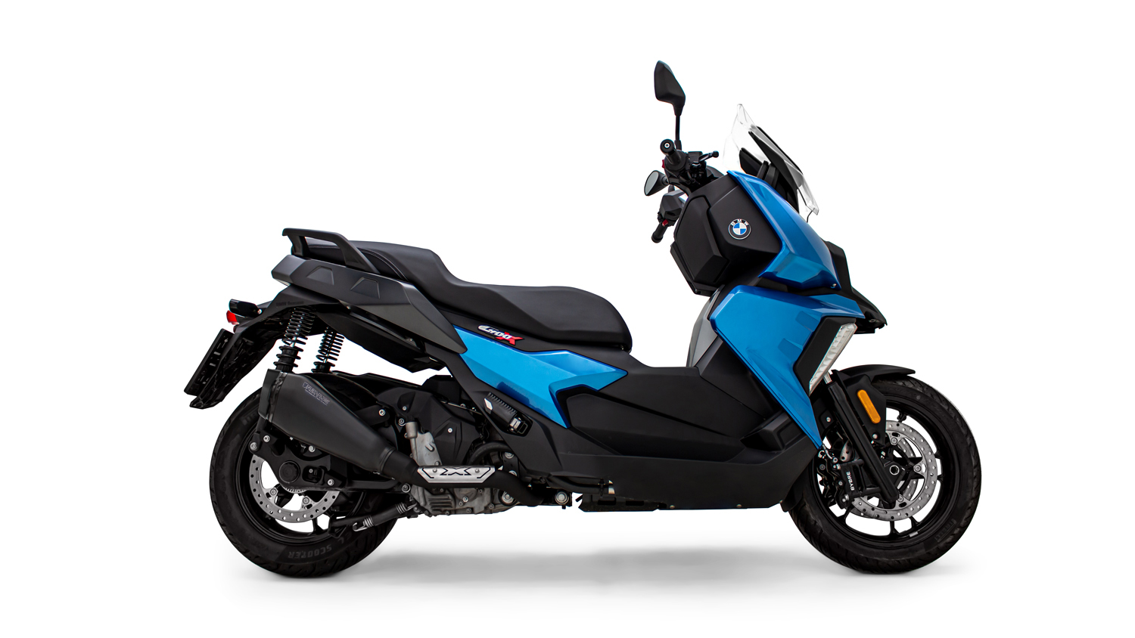
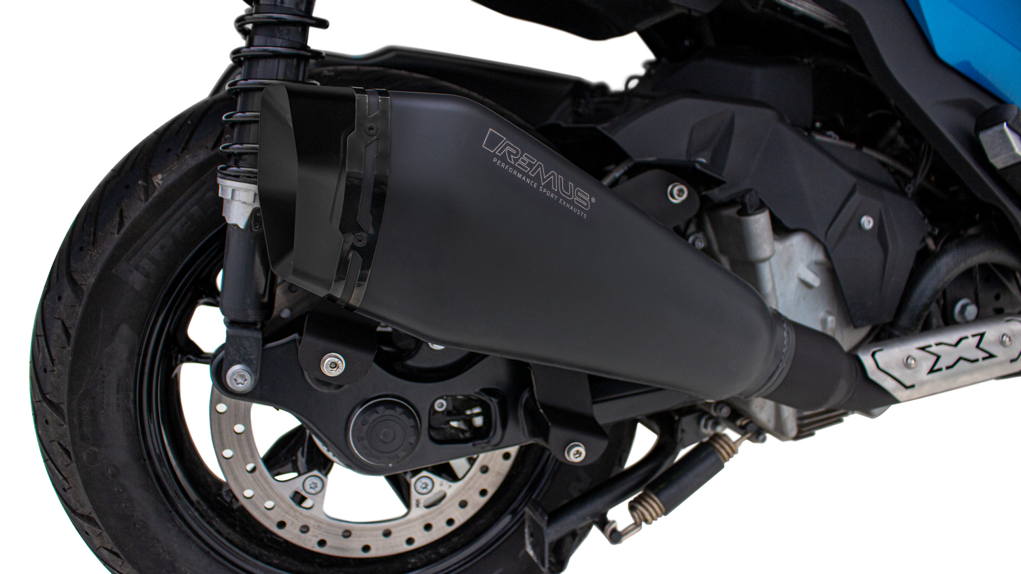
BMW C 400 X/ C 400 GT MY19-
REMUS RS Edelstahl schwarz, Endkappe: Aluminium schwarz / REMUS RS stainless steel black, end cap: aluminium black
Gewicht / weight:
Serie / stock: | REMUS RS:
6,32 kg | 4,70 kg

Slide 4
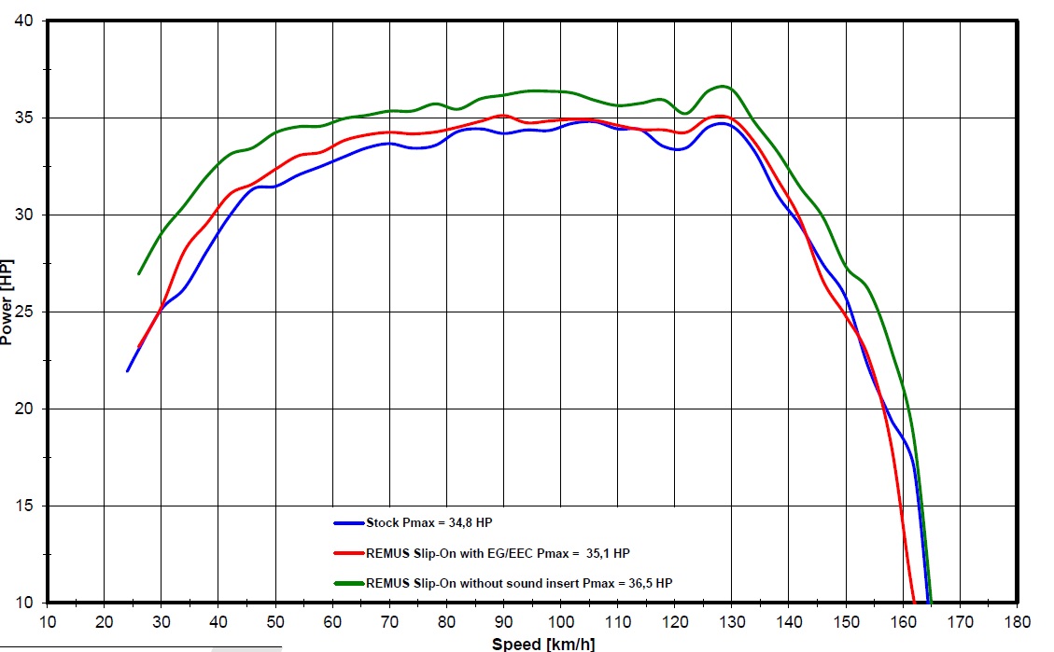
BMW C 400 X/ C 400 GT MY19-
Leistungsdiagramm – Slip-On REMUS RS
Dynochart– Slip-On REMUS RS
FACTORY FACTS:
inkl. EG-Genehmigung/
incl. homologation
+ 1,9 hp at 34 km/h
FACTORY FACTS:
Race system without
sound insert
+ 4,3 hp at 34km/h

Slide 5
BMW C 400 X/ C 400 GT MY19-
Artikelnummern/ part numbers

Slide 6
BMW C 400 X/ C 400 GT MY19-
Artikelnummern/ part numbers

