Slide 1
Harley Davidson Touring FLTRXSE CVO Road Glide 117 MY 2018
08/2019

Slide 2
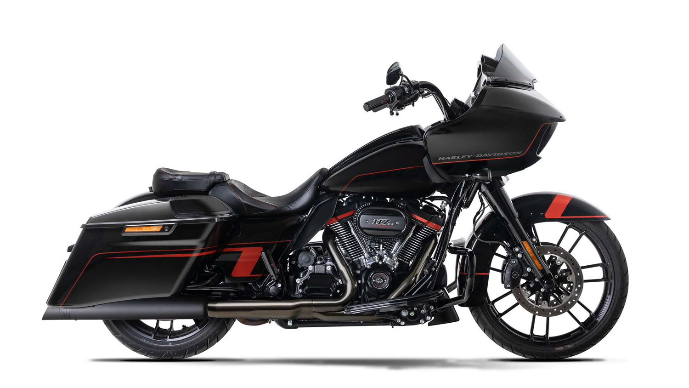
Harley Davidson Touring FLTRXSE CVO Road Glide 117 MY 2018

Slide 3
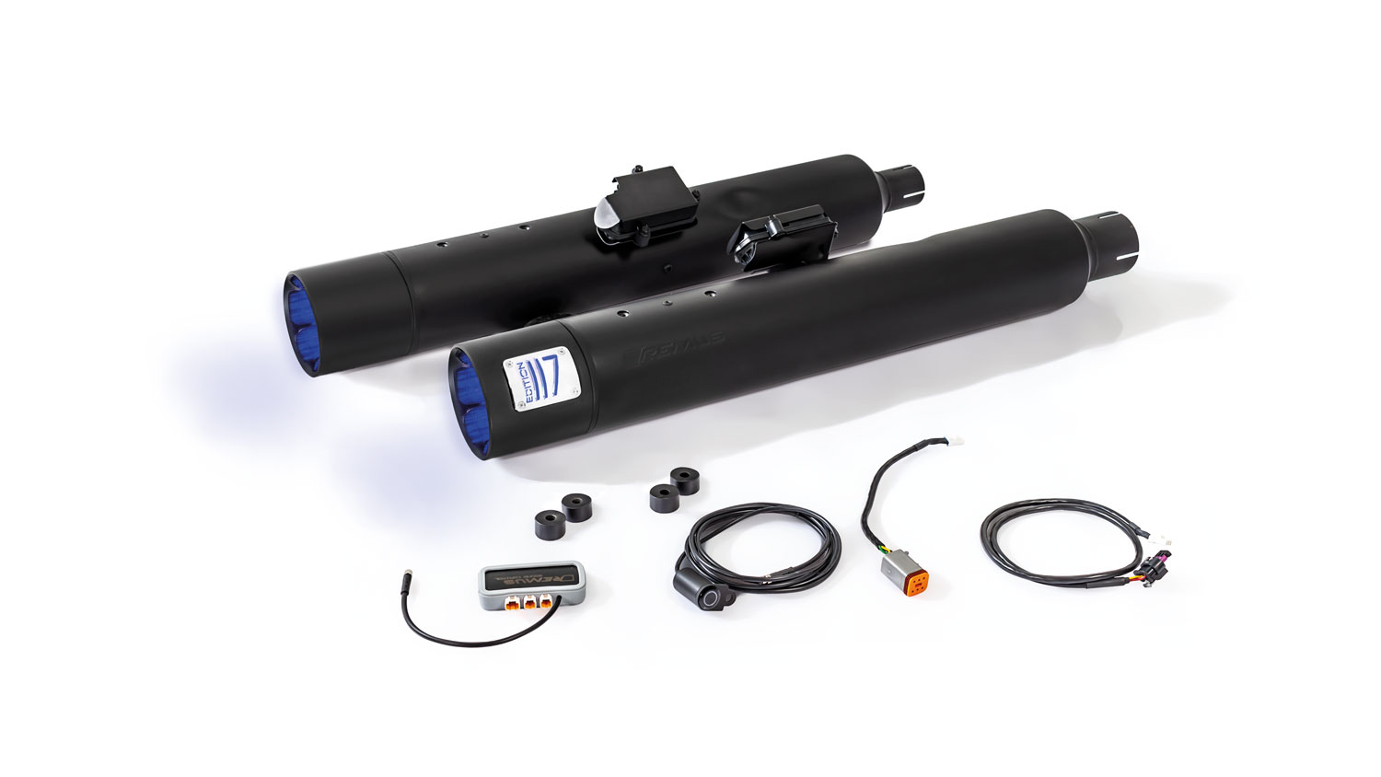
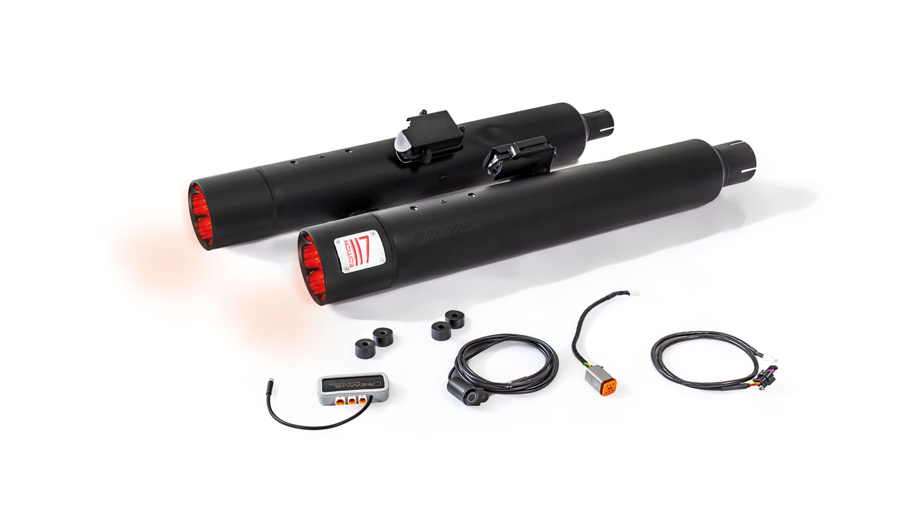
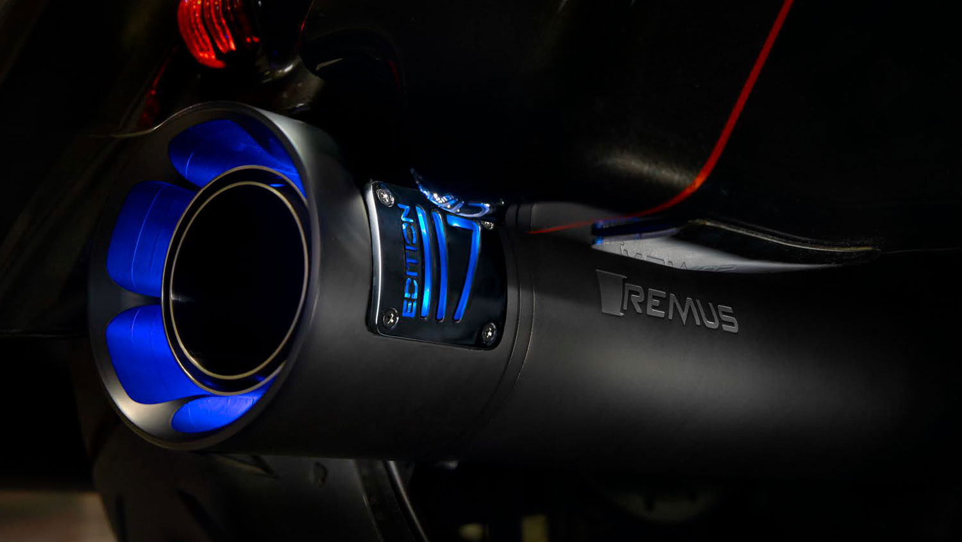
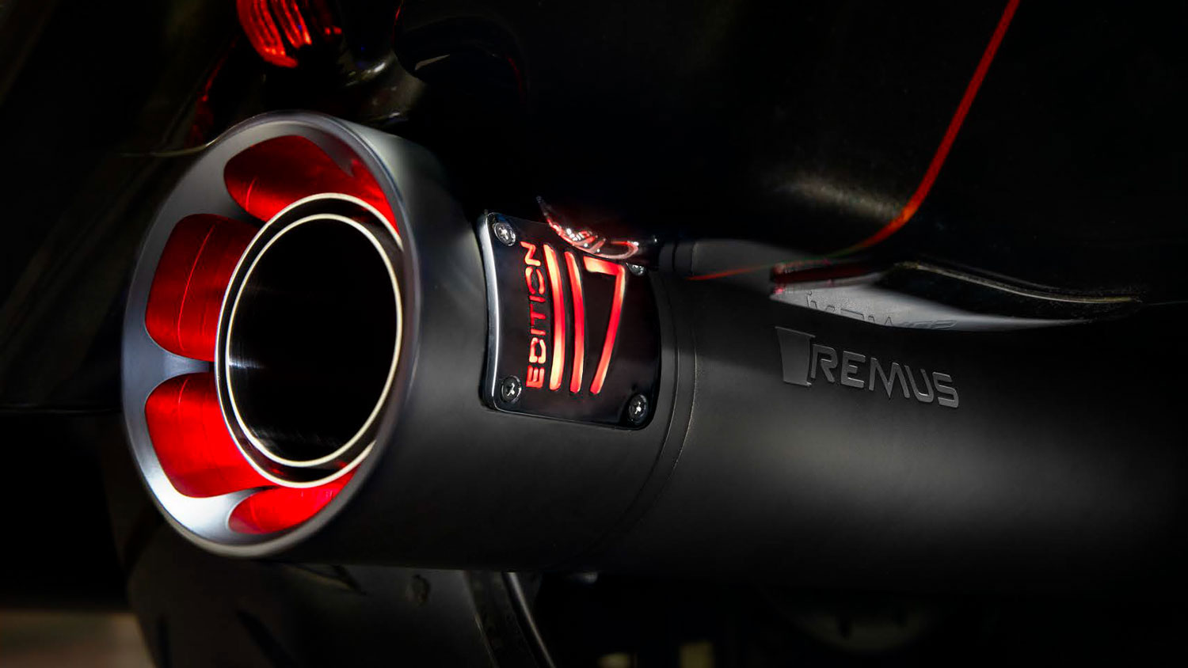
Harley Davidson Touring FLTRXSE CVO Road Glide 117 MY 2018
REMUS CUSTOM Schalldämpfer mit ASC (CAN-Bus gesteuertes Klappensystem) mit beleuchteten Endkappen blau/rot REMUS CUSTOM exhaust with ASC (CAN-Bus actuated sound system) with lighting endcaps blue/red

Slide 4
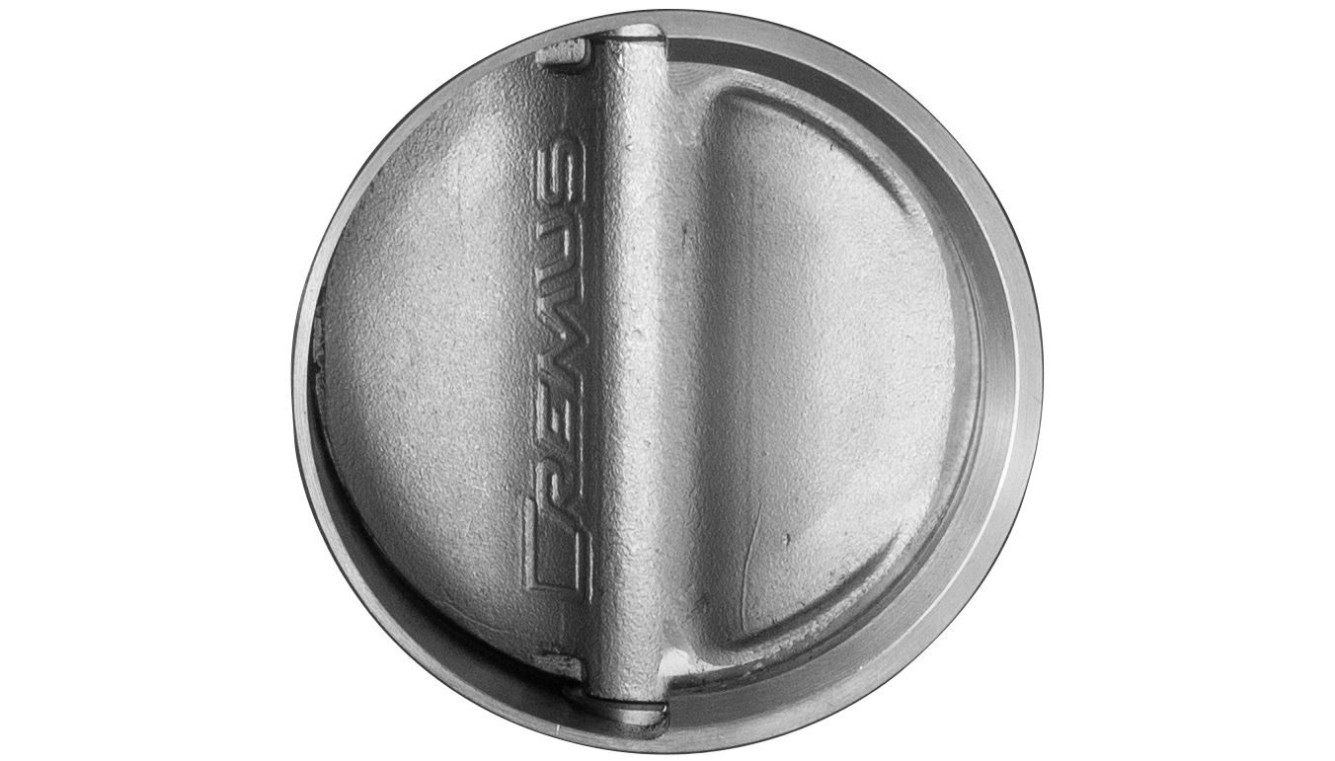
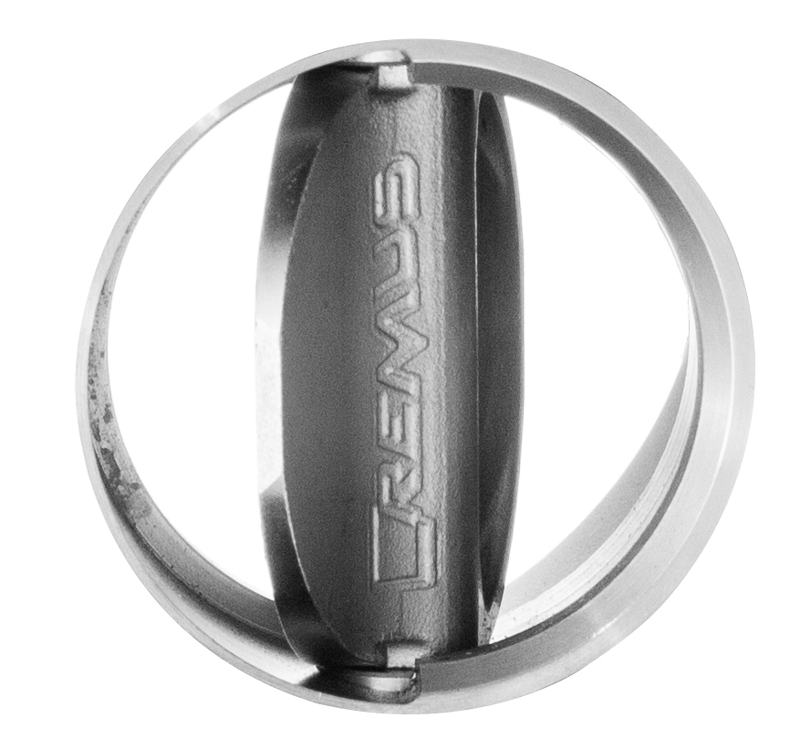
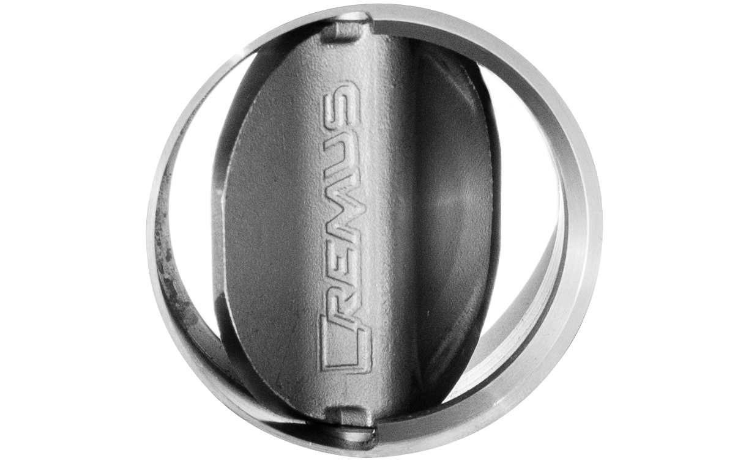
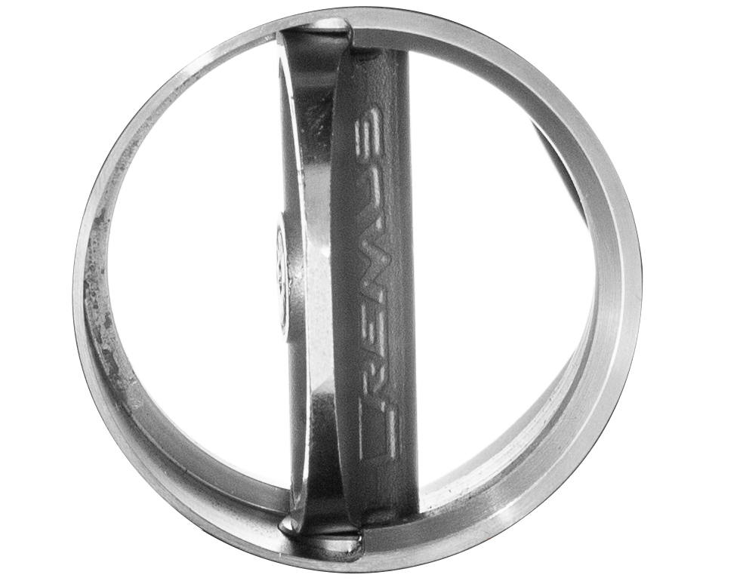
Harley Davidson Touring FLTRXSE CVO Road Glide 117 MY 2018
REMUS CUSTOM Schalldämpfer mit ASC (CAN-Bus gesteuertes Klappensystem) / REMUS CUSTOM exhaust with ASC (CAN-Bus actuated sound system)
Taster / push button: LED Ring AUS Klappe geschlossen / LED loop OFF valve closed
Taster / push button: LED Ring GRÜN Klappe Position 1 / LED loop GREEN valve position 1
Taster / push button: LED Ring GELB Klappe Position 2 / LED loop YELLOW valve position 2
Taster / push button: LED Ring ROT Klappe offen / LED loop RED valve open
CAN-BUS gesteuertes Klappensystem / CAN-bus controlled valve system
Soundmodulation per Taster / Sound modulation via push button switch
Endkappen wählbar und wechselbar / Selectable and changeable end caps
EG Genehmigung / EC homologation

Slide 5
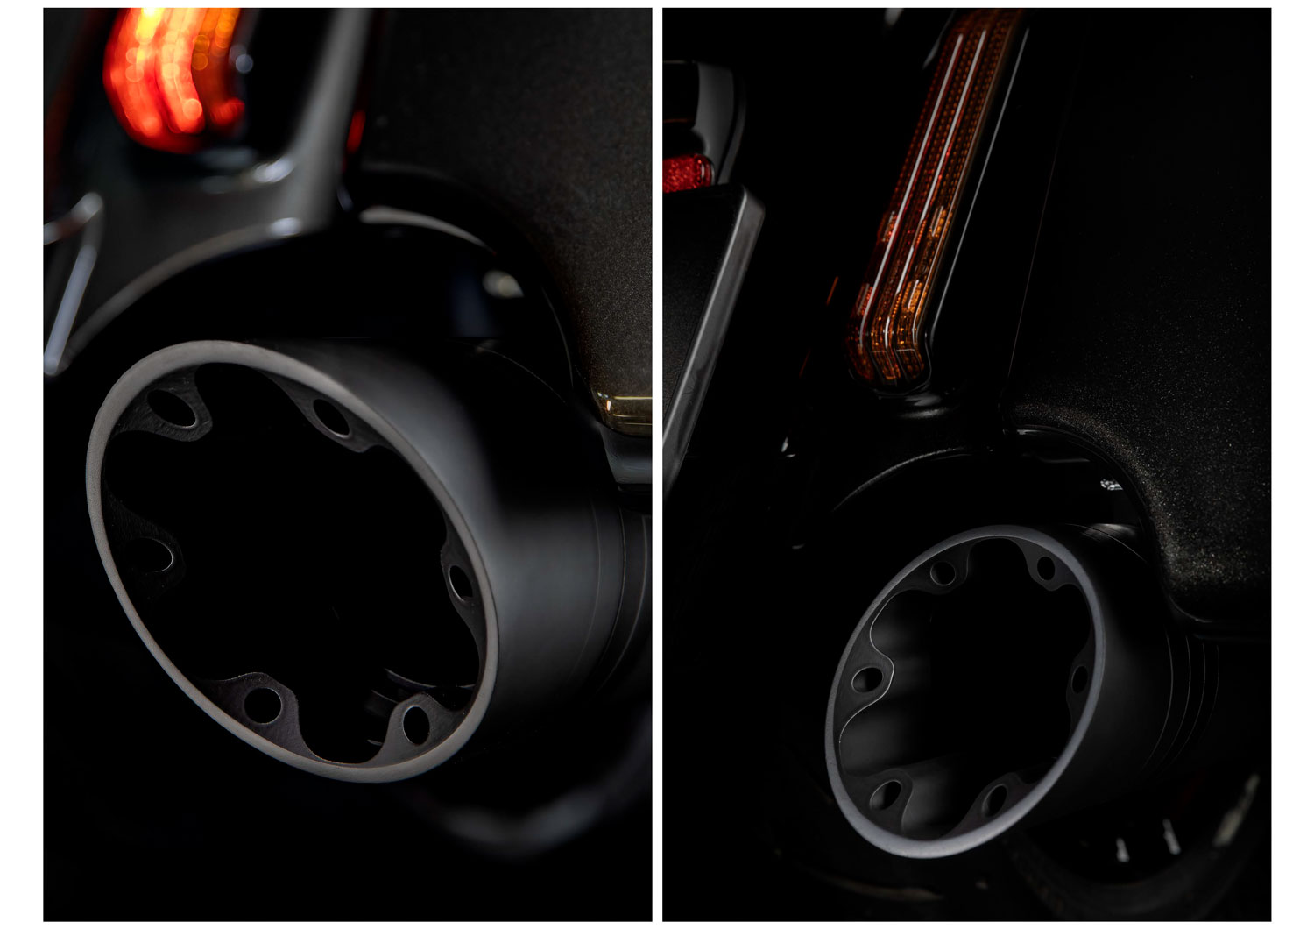
Harley Davidson Touring FLTRXSE CVO Road Glide 117 MY 2018
Endkappen schwarz / End caps black

Slide 6
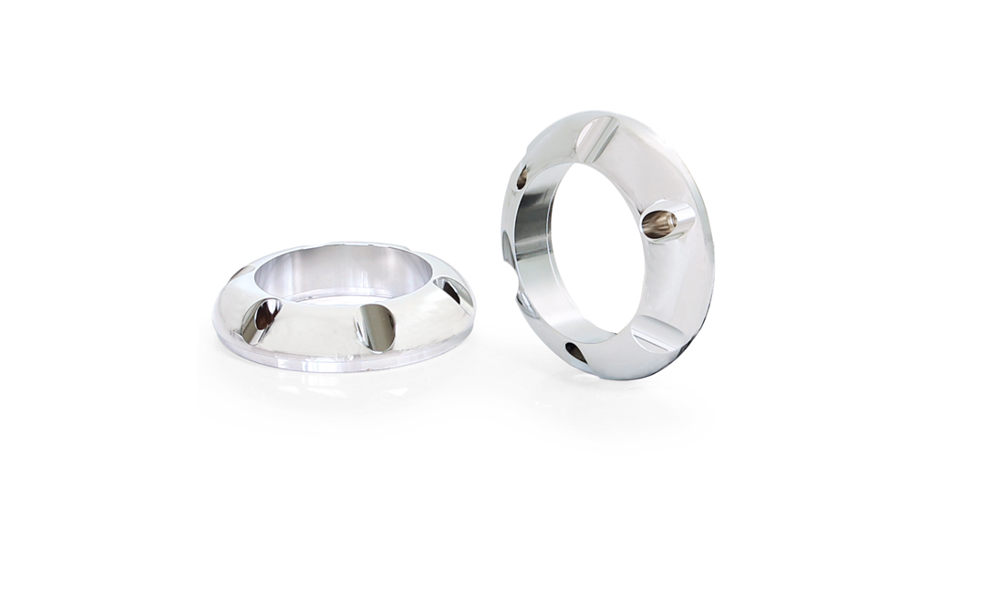
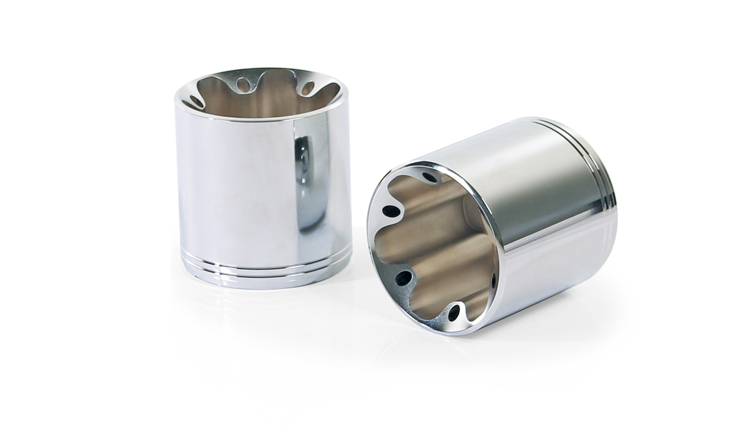
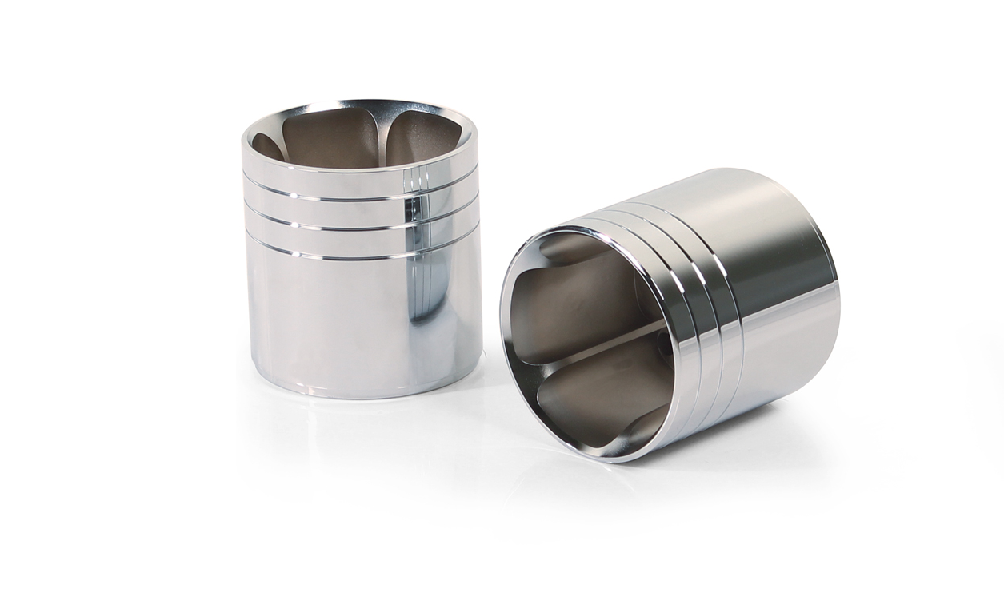
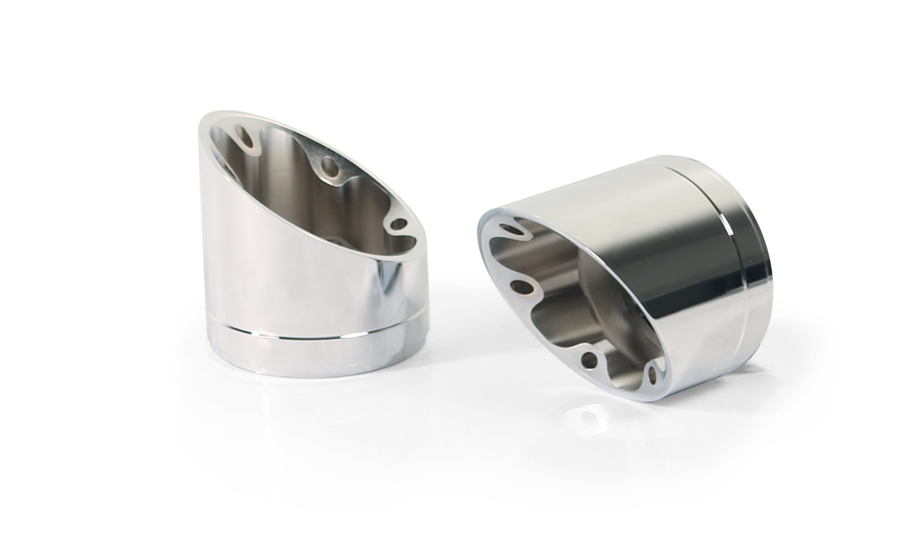
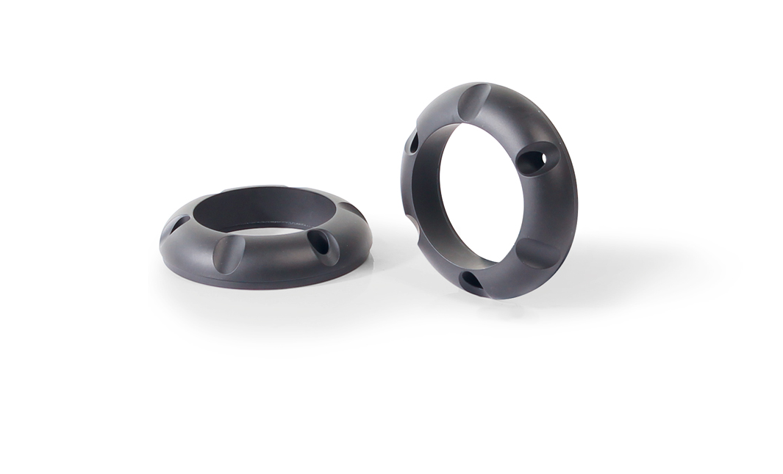
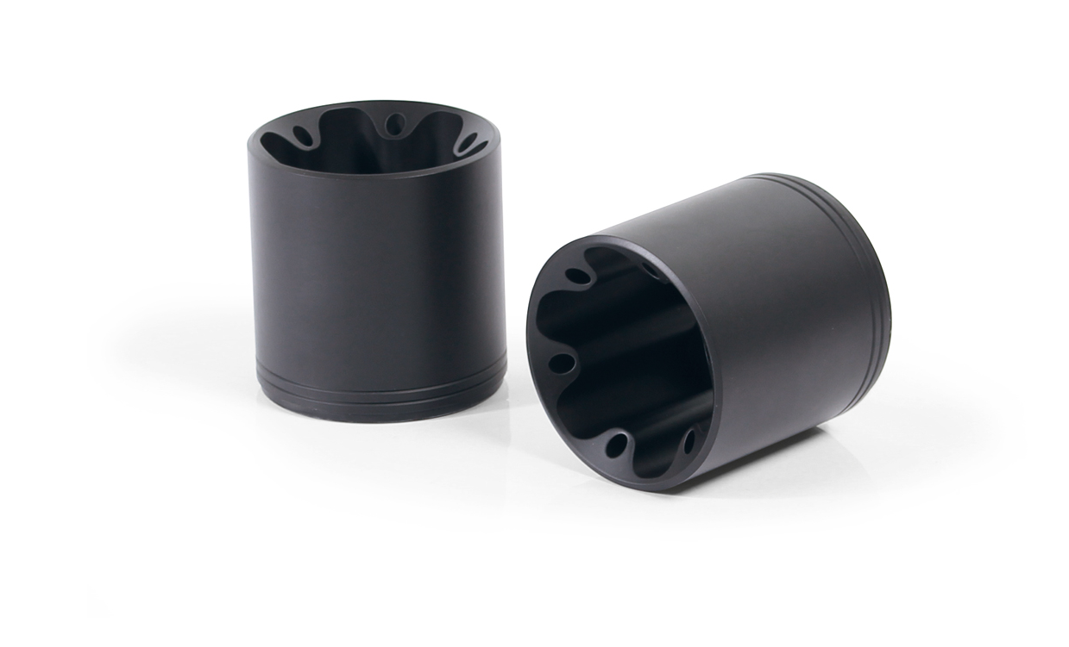
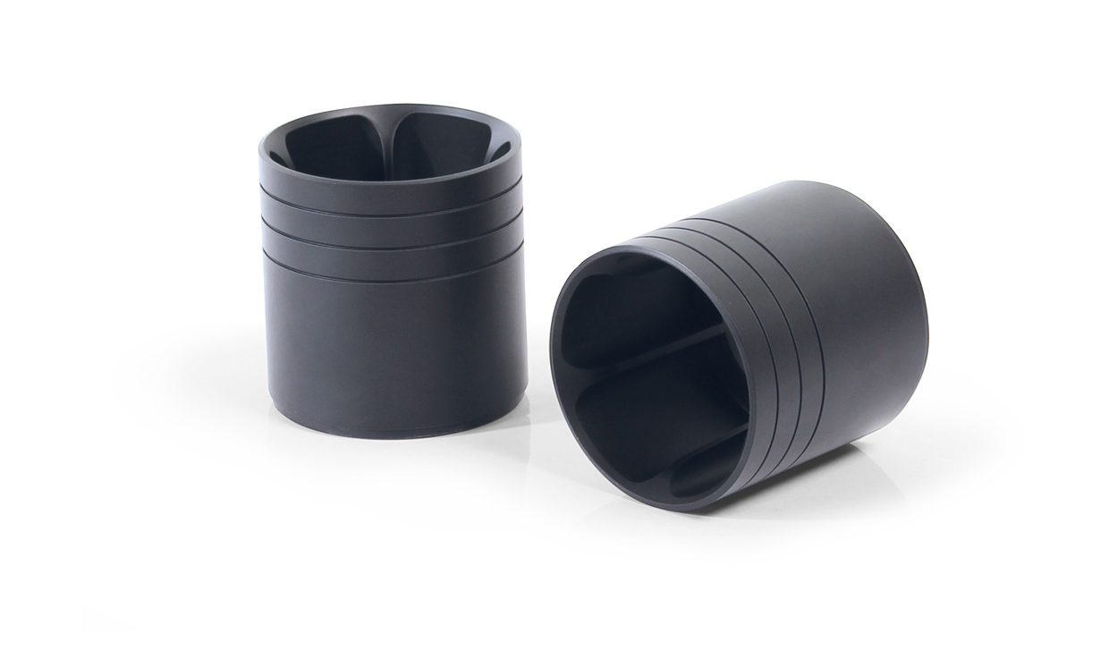
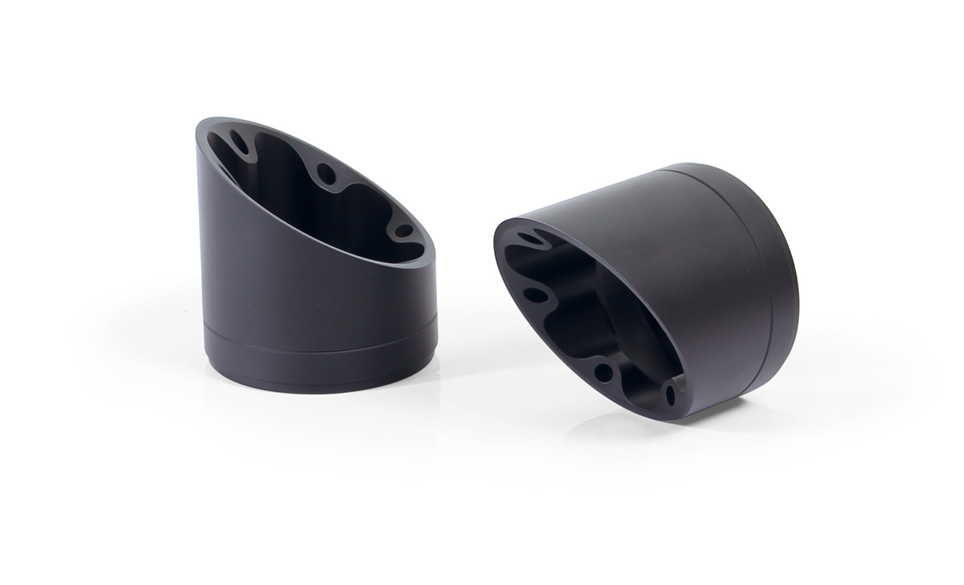
Harley Davidson Touring FLTRXSE CVO Road Glide 117 MY 2018
Endkappen / End caps
Short Cut V1 (EK40)
Straight End V1 (EK41)
Straight End V2 (EK42)
Slash Cut V1 (EK43)
Short Cut V1 (EK60)
Straight End V1 (EK61)
Straight End V2 (EK62)
Slash Cut V1 (EK63)

Slide 7
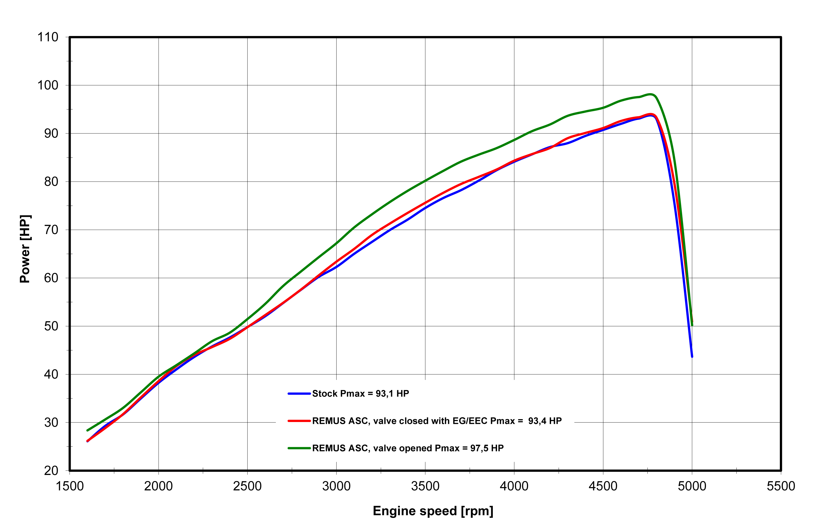
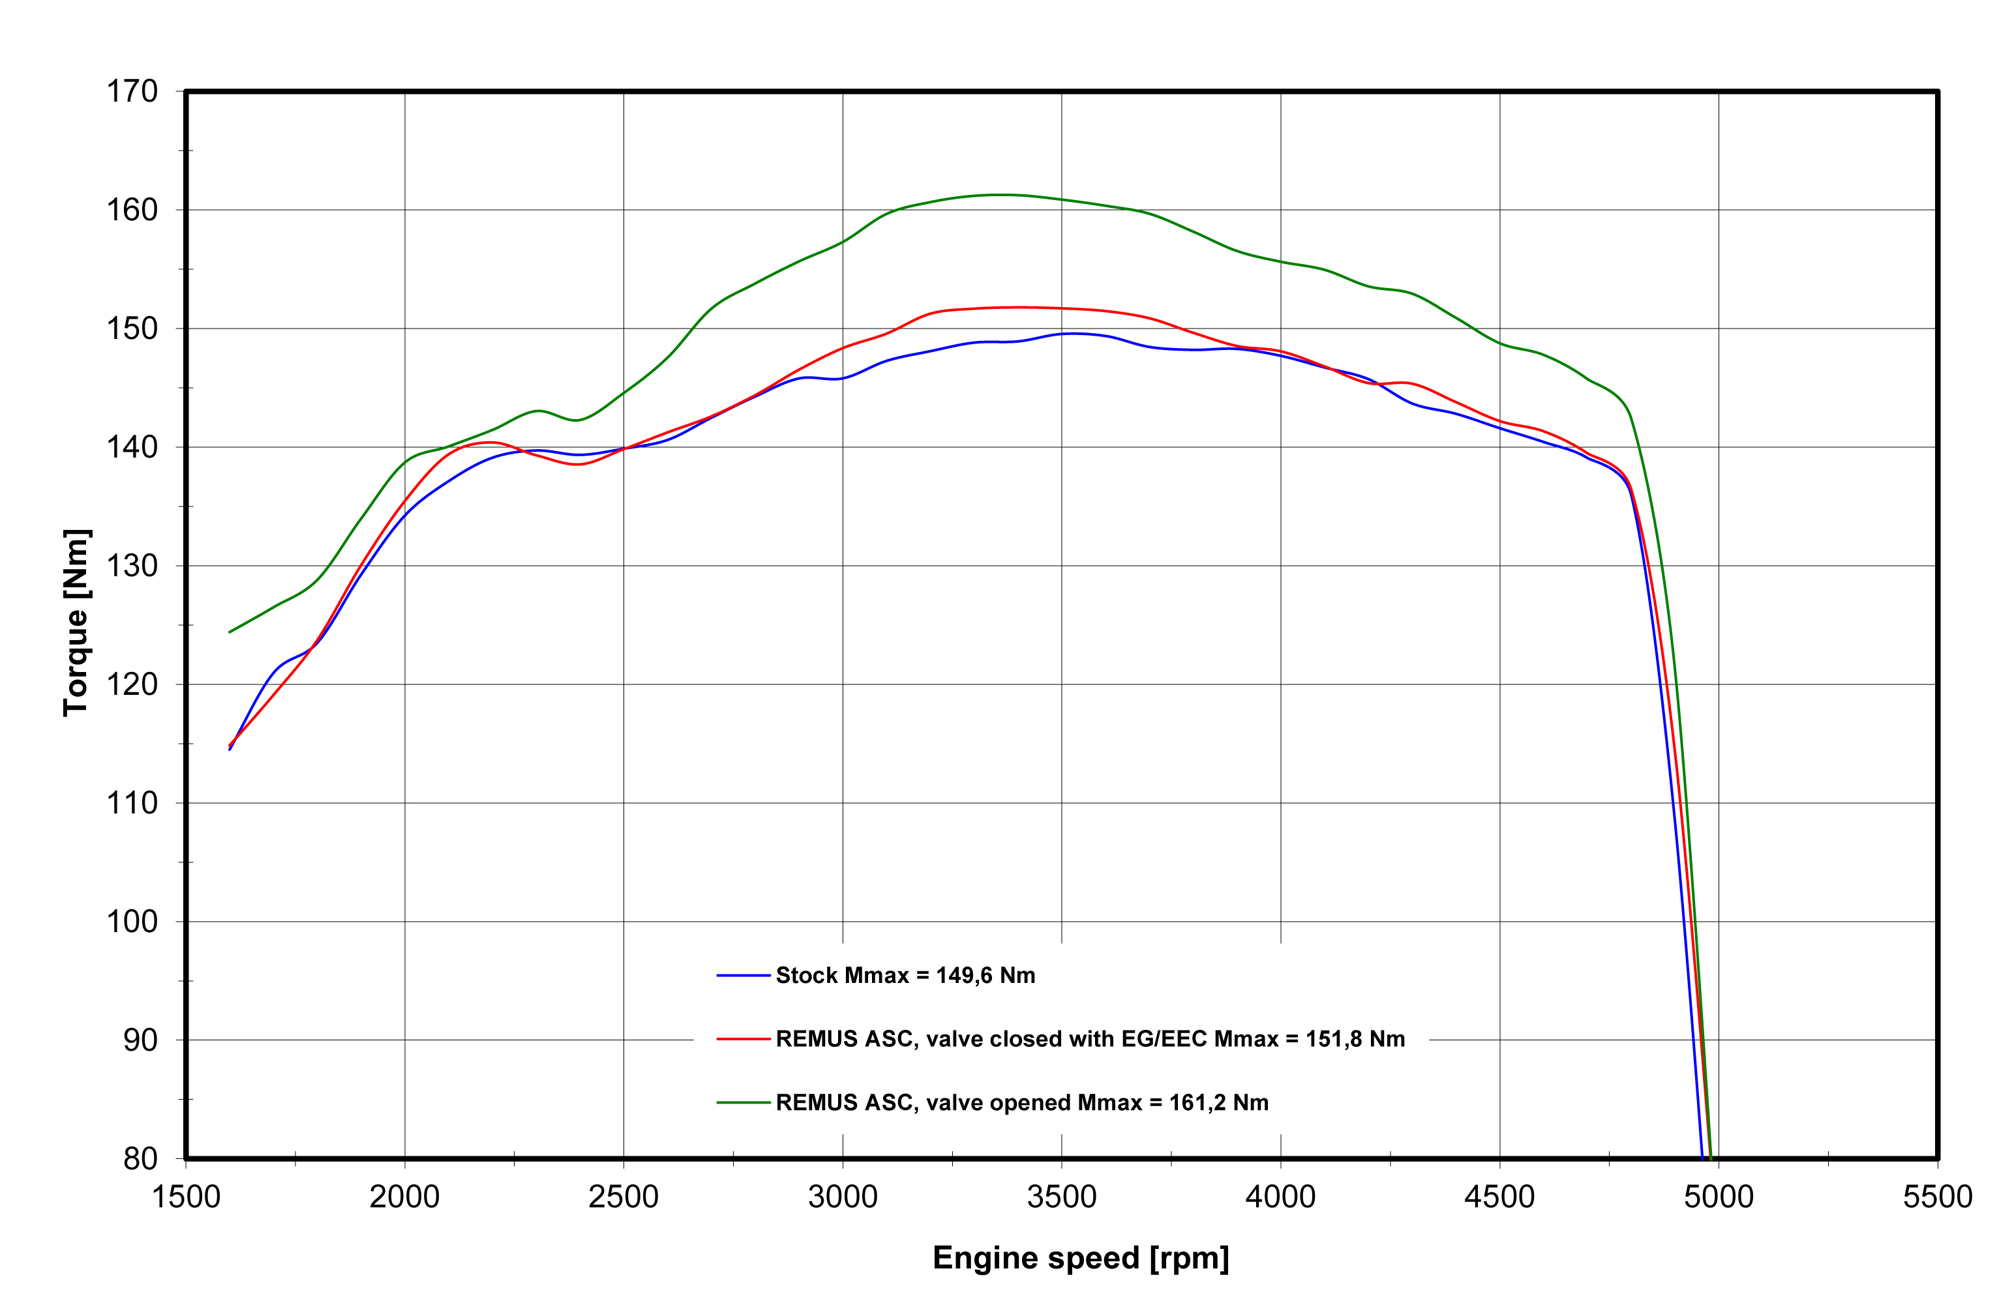
Harley Davidson Touring FLTRXSE CVO Road Glide 117 MY 2018
Leistungsdiagramm / Dyno chart – Slip-On + ASC EG/ABE/EEC
FACTORY FACTS:
bei offener Klappe/ with open valve
+ 6,0 PS / 3400 rpm
+ 12,3 NM / 3400 rpm

Slide 8
Harley Davidson Touring FLTRXSE CVO Road Glide 117 MY 2018
Artikelnummer / Part number
Modell / type | Bj. / year | Beschreibung | description | Typ / type | Mantelvariante | Sleeve version | Art. Nr. / part no. | EUR exkl. MwSt. EUR excl. VAT
Touring FLTRXSE (Euro 4) Milwaukee Eight | 18- | CUSTOM Schalldämpfer und Design der Endkappe wählbar, beides nur gemeinsam montierbar | Custom exhaust and selectable end cap design only fits as a complete system
FLTRXSE CVO Road Glide FLHXSE CVO Street Glide FLHTKSE CVO Limited |  | Schalldämpfer mit beleuchteter Endkappe ASC – (CAN-Bus gesteuertes Klappensystem) | Silencer with luminous end cap ASC – (CAN-BUS actuated sound system) | EG/ABE/EEC | Edelstahl chrom | stainless steel chrome | 007102 303017LR | 2.400,--
 |  | Schalldämpfer mit beleuchteter Endkappe ASC – (CAN-Bus gesteuertes Klappensystem) | Silencer with luminous end cap ASC – (CAN-BUS actuated sound system) | EG/ABE/EEC | Edelstahl schwarz | stainless steel black | 007702 303017LR | 2.458,--
 |  | 2 x CUSTOM Schalldämpfer Ø 102 mm ohne Kat., ohne Endkappe ASC – (CAN-Bus gesteuertes Klappensystem) | 2 x CUSTOM exhaust Ø 102 mm no cat., no end cap ASC – (CAN-BUS actuated sound system) | EG/ABE/EEC | Edelstahl chrom | stainless steel chrome | 007102 293017LR | 1.810,--
 |  |  |  | EG/ABE/EEC | Edelstahl schwarz | stainless steel black | 007702 293017LR | 1.872,--
 |  | Wählbare Endkappen müssen separat bestellt werden | Selectable end caps must be ordered separately
 |  | Endkappe Straight End V1 (2 Stk.) | Endcap straight end V1 (2 pcs.) |  | Alu chrom | alloy chrome | EK41 | 240,--
 |  |  |  |  | Alu schwarz | alloy black | EK61 | 260,--
 |  | Endkappe Straight End V2 (2 Stk.) | Endcap straight end V2 (2 pcs.) |  | Alu chrom | alloy chrome | EK42 | 220,--
 |  |  |  |  | Alu schwarz | alloy black | EK62 | 240,--
 |  | Endkappe Slash Cut V1 (2 Stk.) | Endcap slash cut V1 (2 pcs.) |  | Alu chrom | alloy chrome | EK43 | 260,--
 |  |  |  |  | Alu schwarz | alloy black | EK63 | 280,--
 |  | Verlängerung chrom SET, 25 mm (Set inkl. Schrauben) | Extension chrome SET, 25 mm (set of screws) |  | chrom | chrome | EKV105C | 149,--
 |  | Verlängerung schwarz SET, 25 mm (Set inkl. Schrauben) | Extension black SET, 25 mm (set of screws) |  | schwarz | black | EKV105S | 129,--
Preise 2019 in Euro exkl. MwSt. / Prices 2019 in Euro excl. VAT Irrtum und Änderungen vorbehalten! / Errors and omission excepted!

