Slide 1
Harley Davidson Touring 107+114 MY 2017-
/2019

Slide 2
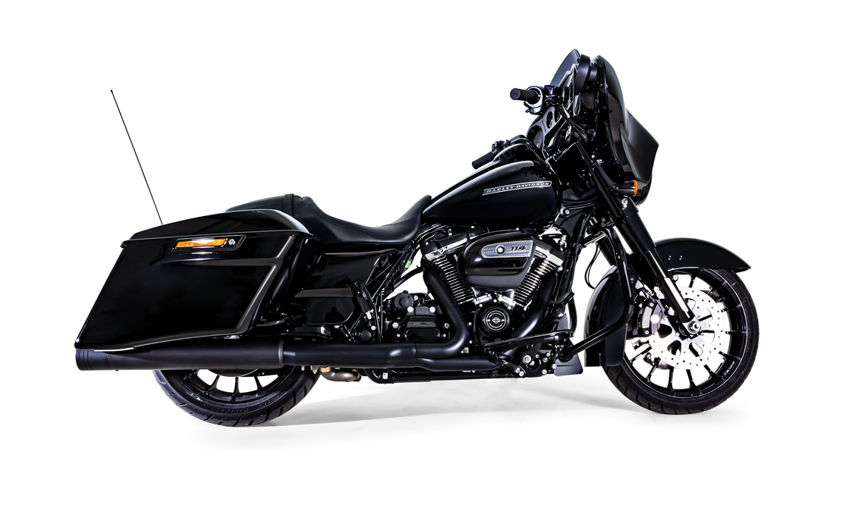
Harley Davidson Touring 107+114 MY 2017-

Slide 3
Harley Davidson Touring 107+114 MY 2017-

Slide 4
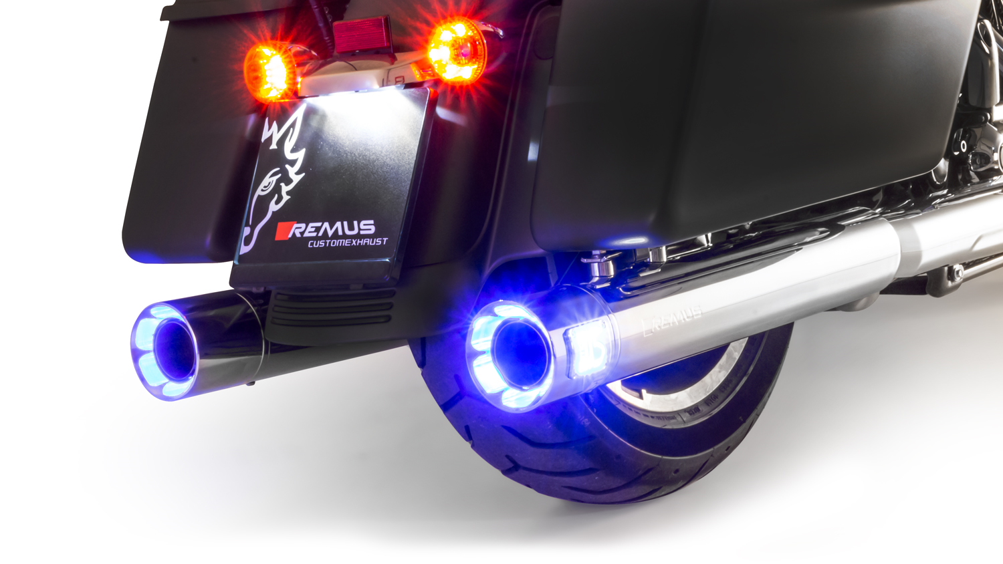
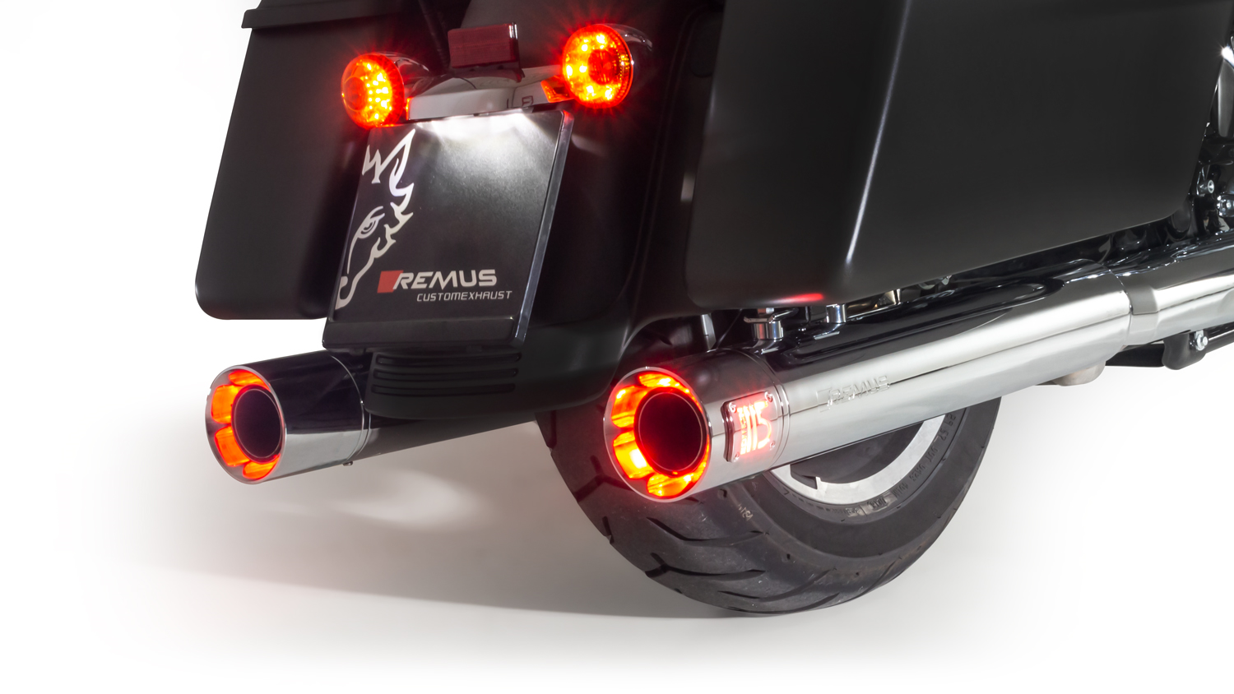
Harley Davidson Touring 107+114 MY 2017-
Limited Edition 115 Anniversary; lighting endcap blue/red

Slide 5
Harley Davidson Touring 107+114 MY 2017-
REMUS CUSTOM Schalldämpfer mit ASC (CAN-Bus gesteuertes Klappensystem) / REMUS CUSTOM exhaust with ASC (CAN-Bus actuated sound system)
Taster / push button: LED Ring AUS Klappe geschlossen / LED loop OFF valve closed
Taster / push button: LED Ring GRÜN Klappe 10% offen / LED loop GREEN valve 10% open
Taster / push button: LED Ring GELB Klappe 40% offen / LED loop YELLOW valve 40% open
Taster / push button: LED Ring ROT Klappe 100% offen / LED loop RED valve 100% open
CAN-BUS gesteuertes Klappensystem / CAN-bus controlled valve system
Soundmodulation per Taster / Sound modulation via push button switch
Endkappen wählbar und wechselbar / Selectable and changeable end caps
EG Genehmigung / EC homologation

Slide 6
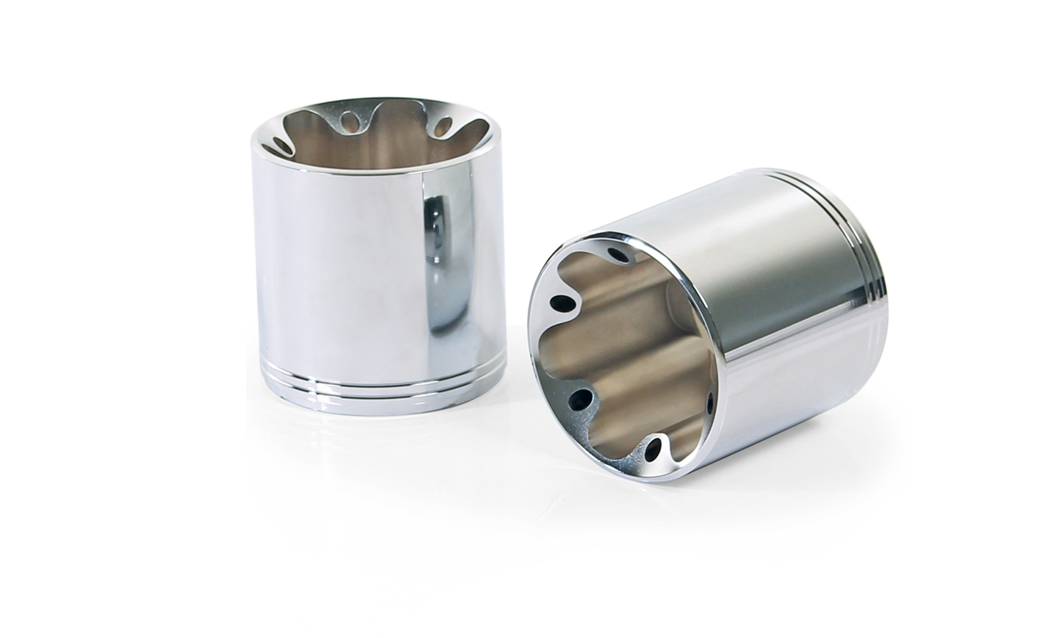
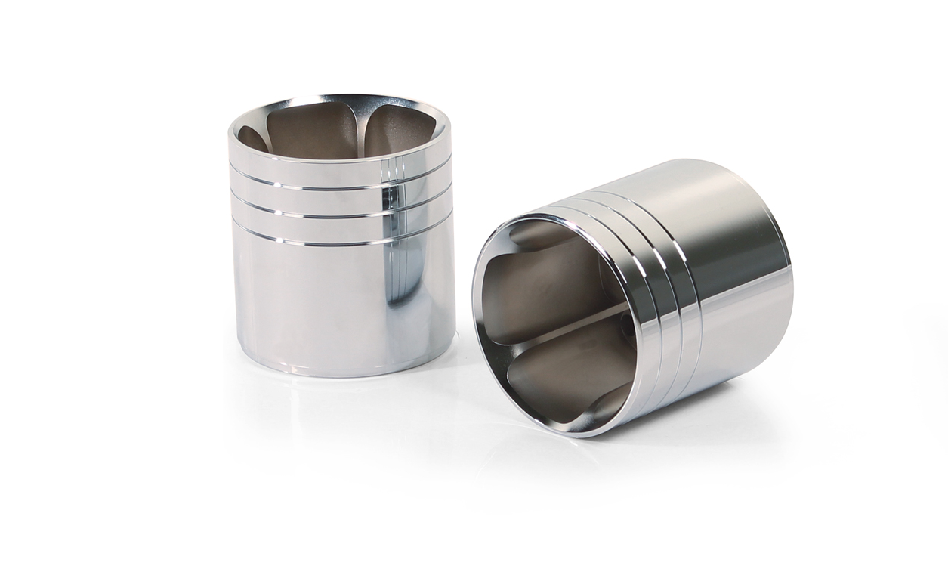
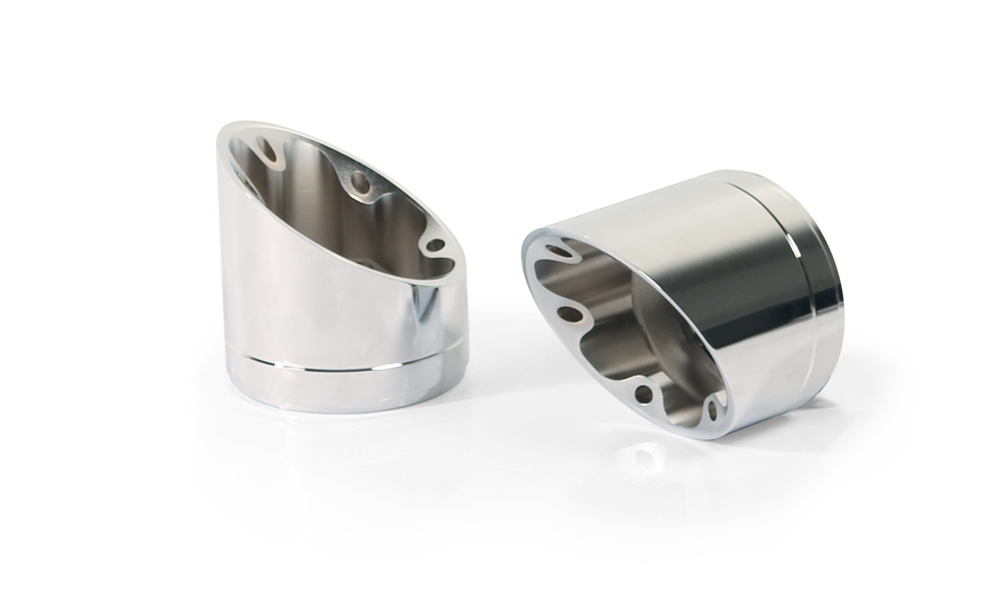
Harley Davidson Touring 107+114 MY 2017-
Endkappen / End caps
Straight End V1 (EK41)
Straight End V2 (EK42)
Slash Cut V1 (EK43)
Straight End V1 (EK61)
Straight End V2 (EK62)
Slash Cut V1 (EK63)

Slide 7
Harley Davidson Touring 107+114 MY 2017-
Leistungsdiagramm / Dyno chart
FACTORY FACTS:
bei offener Klappe/with open valve
+ 5,7 HP / 3300 rpm
+ 10,4 NM/ 3300 rpm

Slide 8
Harley Davidson Touring 107+114 MY 2017-
Artikelnummer / Part number
Modell / type | Bj. / year | Beschreibung | description | Typ / type | Mantelvariante | Sleeve version | Art. Nr. / part no. | EUR exkl. MwSt. EUR excl. VAT
Touring, FL 3 (EURO 4) Milwaukee Eight | 17- | CUSTOM Schalldämpfer und Design der Endkappe wählbar, beides nur gemeinsam montierbar | Custom exhaust and selectable end cap design only fits as a complete system
FLHR Road King FLHRC Road King Classic FLHRXS Road King Special FLHX Street Glide FLTRX Road Glide FLHXS Street Glide Special FLTRXS Road Glide Special FLTRU Road Glide Ultra FLHTK Ultra Limited FLHTKL Ultra Limited Low |  | Schalldämpfer mit beleuchteter Endkappe ASC – (CAN-Bus gesteuertes Klappensystem) | Silencer with luminous end cap ASC – (CAN-BUS actuated sound system) | EG/ABE/EEC | Edelstahl chrom | stainless steel chrome | 007102 303017LR | 2.400,--
 |  | Schalldämpfer mit beleuchteter Endkappe ASC – (CAN-Bus gesteuertes Klappensystem) | Silencer with luminous end cap ASC – (CAN-BUS actuated sound system) | EG/ABE/EEC | Edelstahl schwarz | stainless steel black | 007702 303017LR | 2.458,--
 |  | 2 x CUSTOM Schalldämpfer Ø 102 mm ohne Kat., ohne Endkappe ASC – (CAN-Bus gesteuertes Klappensystem) | 2 x CUSTOM exhaust Ø 102 mm no cat., no end cap ASC – (CAN-BUS actuated sound system) | EG/ABE/EEC | Edelstahl chrom | stainless steel chrome | 007102 293017LR | 1.740,--
 |  |  |  | EG/ABE/EEC | Edelstahl schwarz | stainless steel black | 007702 293017LR | 1.800,--
 |  | Wählbare Endkappen müssen separat bestellt werden | Selectable end caps must be ordered separately
 |  | Endkappe Straight End V1 (2 Stk.) | endcap straight end V1 (2 pcs.) |  | Alu chrom | alloy chrome | EK41 | 240,--
 |  |  |  |  | Alu schwarz | alloy black | EK61 | 260,--
 |  | Endkappe Straight End V2 (2 Stk.) | endcap straight end V2 (2 pcs.) |  | Alu chrom | alloy chrome | EK42 | 220,--
 |  |  |  |  | Alu schwarz | alloy black | EK62 | 240,--
 |  | Endkappe Slash Cut V1 (2 Stk.) | endcap slash cut V1 (2 pcs.) |  | Alu chrom | alloy chrome | EK43 | 260,--
 |  |  |  |  | Alu schwarz | alloy black | EK63 | 280,--
 |  | Verlängerung chrom SET, 25 mm (Set inkl. Schrauben ) | Extension chrome SET, 25 mm (set of screws) |  | Alu chrom | alloy chrome | EKV105C | 149,--
 |  | Verlängerung schwarz SET, 25 mm (Set inkl. Schrauben ) | Extension black SET, 25 mm (set of screws) |  | Alu schwarz | alloy black | EKV105S | 129,--
Preise 2019 in Euro exkl. MwSt. / Prices 2019 in Euro excl. VAT Irrtum und Änderungen vorbehalten! / errors and omission excepted!

