Slide 1
BIKE INFO 04-RACE/2017
+ 4,8 HP
+ 5,3 Nm
- 2,2 kg
Honda CRF1000L Africa Twin Mod. 2017 RACING EXHAUST OPTIONS FOR EXPORT MARKETS

Slide 2
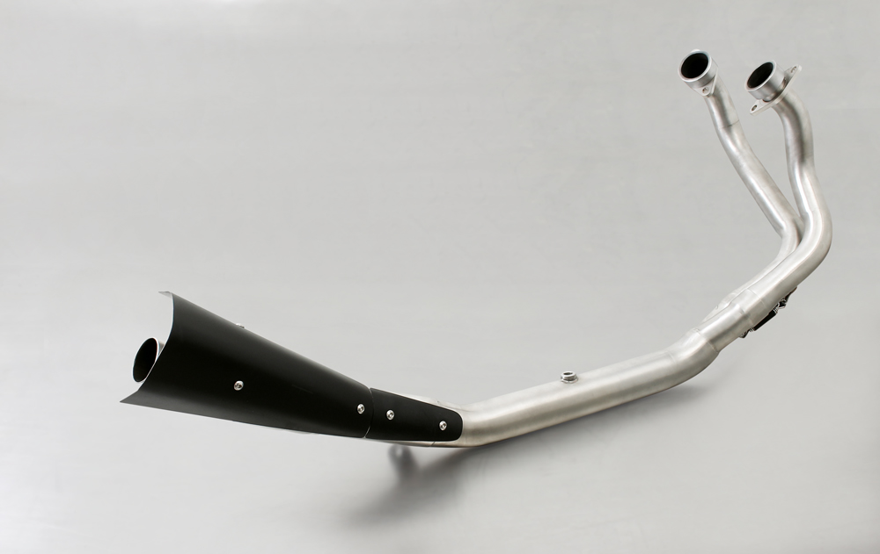
RACING HEADER
Weight (kg)
sleeve | stock | REMUS
 |  | stainless steel
header | 3,20 | 3,00
silencer | 4,80 | 3,10

Slide 3
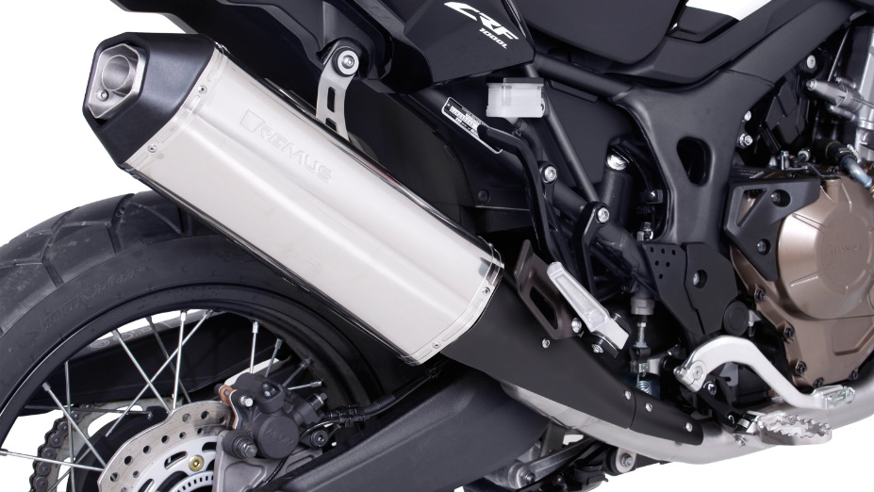
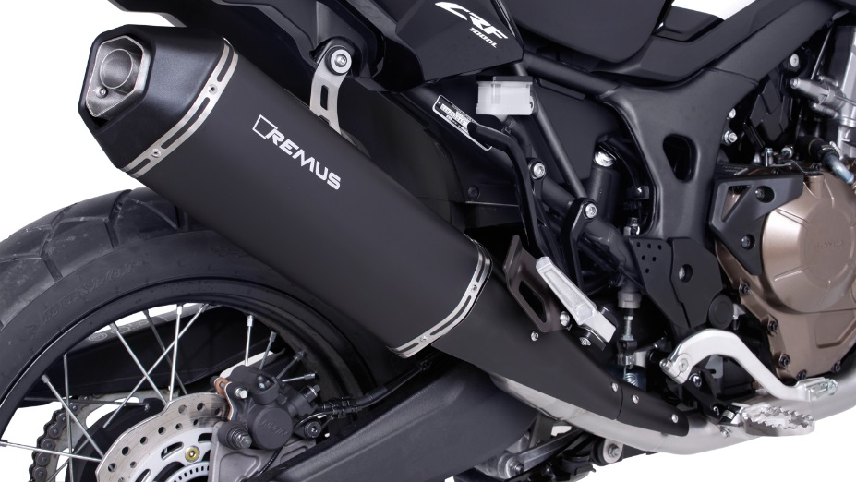
OKAMI RACING EXHAUST

Slide 4
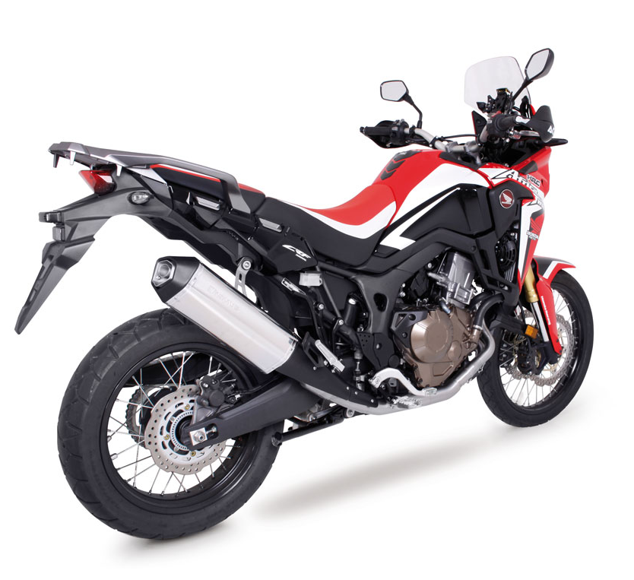

Slide 5
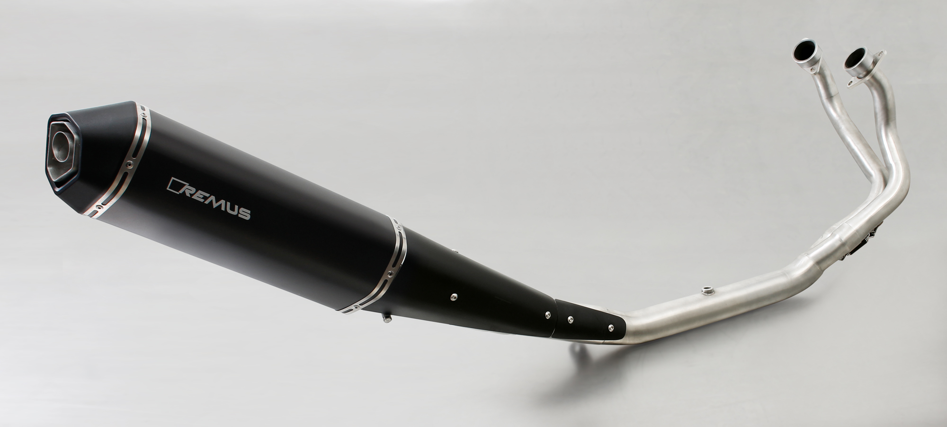
Complete OKAMI de-cat racing system

Slide 6
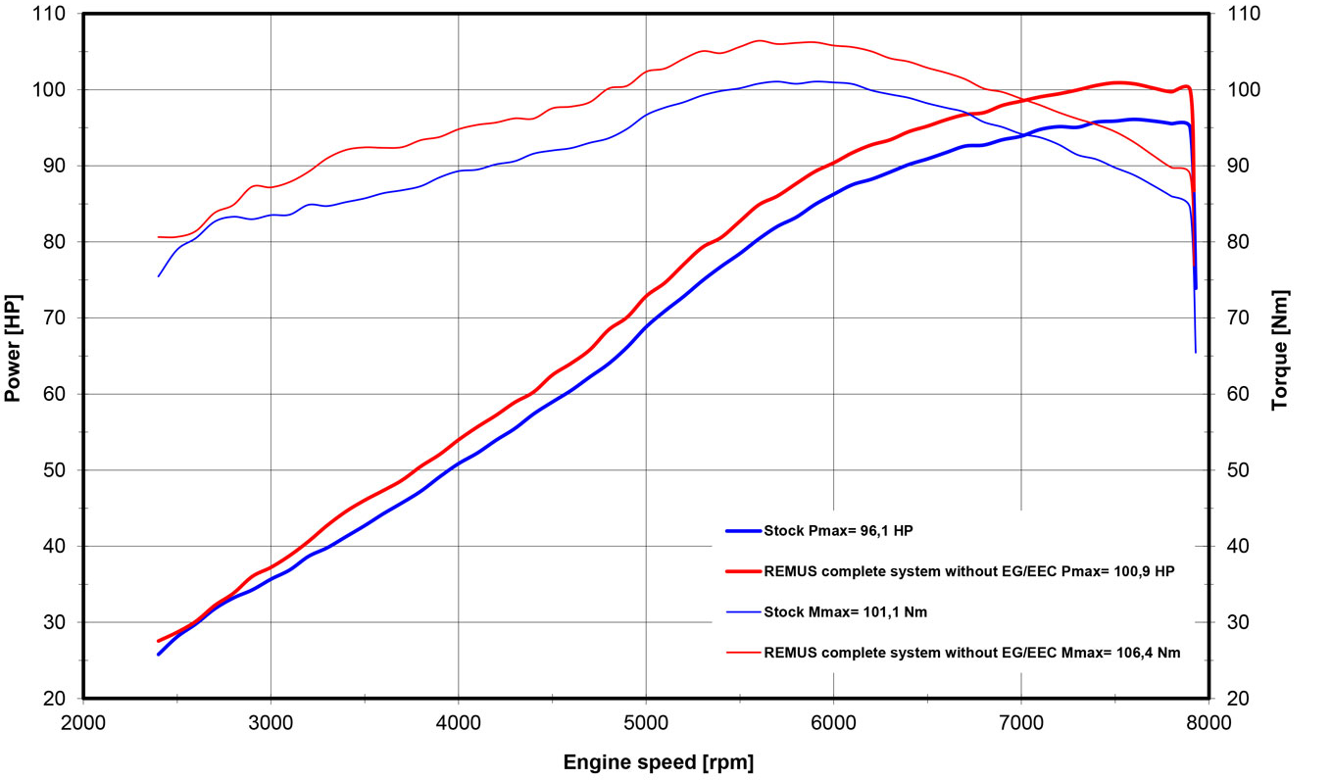
Dyno chart
Technische Änderungen und Irrtümer bleiben vorbehalten. Subject to technical alterations and errors.

Slide 7
Part numbers
PART NUMBERS IN DETAIL
Modell - type | Bj. year | Ømm | description | Typ type | sleeve version | Artikelnummer part number | EUR exkl. MwSt. EUR excl. VAT
CRF1000L Africa Twin 70kW, SD04 | 17- |  | OKAMI with removable sound insert | RACE | stainless steel | 14683 257117 | 334,00
 |  |  | OKAMI with removable sound insert | RACE | stainless steel black | 14783 257117 | 364,00
 |  |  | Stainless steel header (2-1) no cat. incl. black heat shield, fits to REMUS or original exhaust | RACE | stainless steel | 0101 257117 | 461,00
Preise 2017 in Euro exkl. MwSt. / Prices 2017 in Euro excl. VAT! |  |  |  |  | Irrtum und Änderung vorbehalten / Errors and omission excepted
SET PART NUMBERS
Modell - type | Bj. year | Ømm | description | Typ type | Schalldämpfer muffler | sleeve version | Setartikelnummer setpartnumber | EUR exkl. MwSt. EUR excl. VAT
CRF1000L Africa Twin 70kW, SD04 | 17- |  | RACING slip on sport exhaust system with removable sound insert | RACE | OKAMI | stainless steel | 0914683 257117 | 334,00
 |  |  |  | RACE | OKAMI | stainless steel black | 0914783 257117 | 364,00
 |  |  | RACING stainless steel header (2-1) no cat. incl. black heat shield, fits to REMUS or original exhaust | RACE |  | stainless steel | 0101 257117 | 461,00
Preise 2017 in Euro exkl. MwSt. / Prices 2017 in Euro excl. VAT! |  |  |  |  |  | Irrtum und Änderung vorbehalten / Errors and omission excepted

