Slide 1
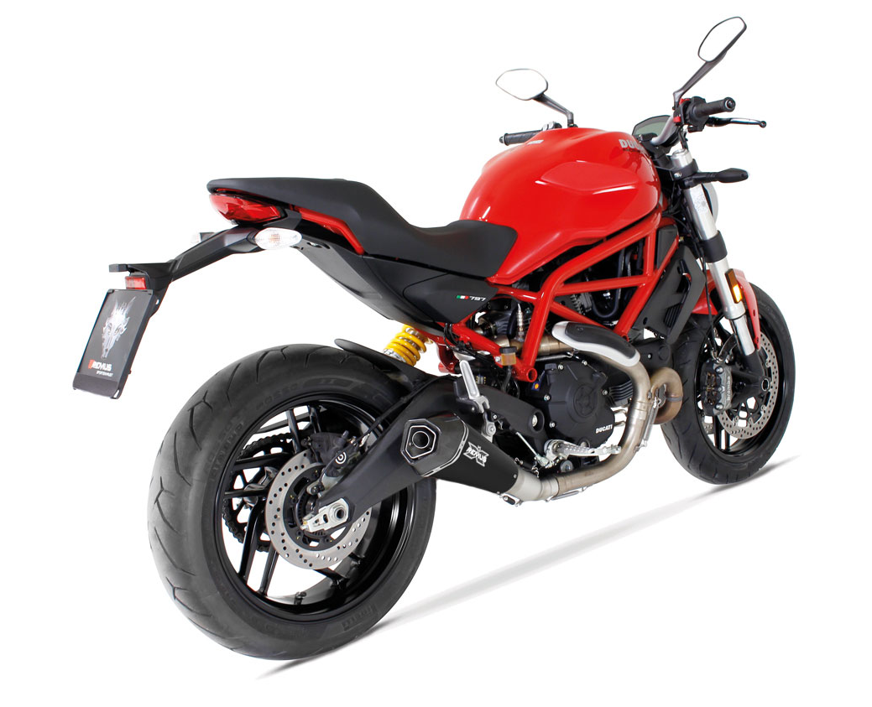
BIKE INFO 21-RACE/2017
+ 3,6 HP
*
+ 3,1 Nm
*
- 3,3 kg
* at 8100 rpm
Ducati Monster 797 2017 RACING EXHAUST OPTIONS FOR EXPORT MARKETS

Slide 2
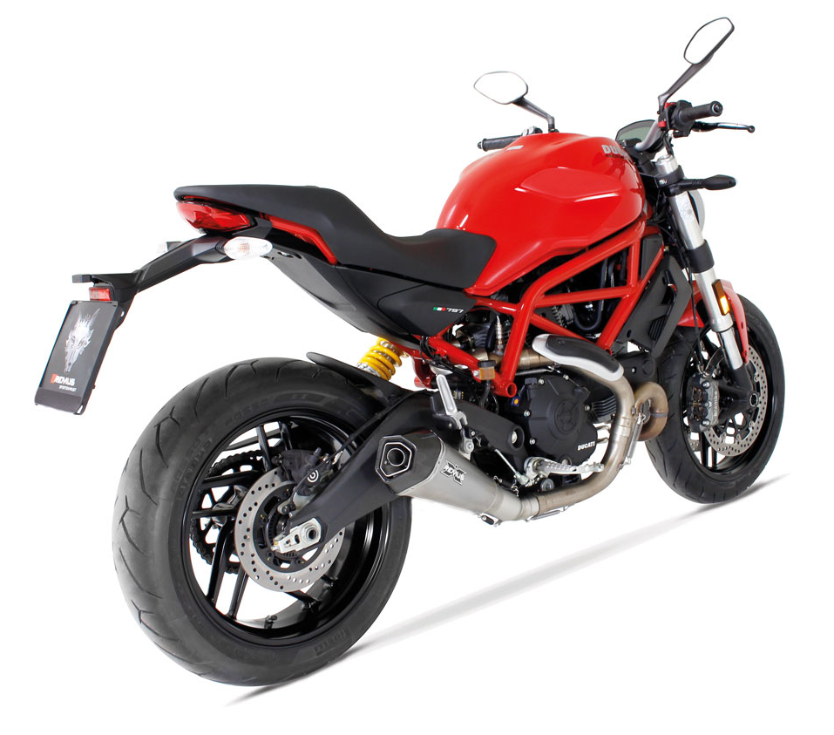
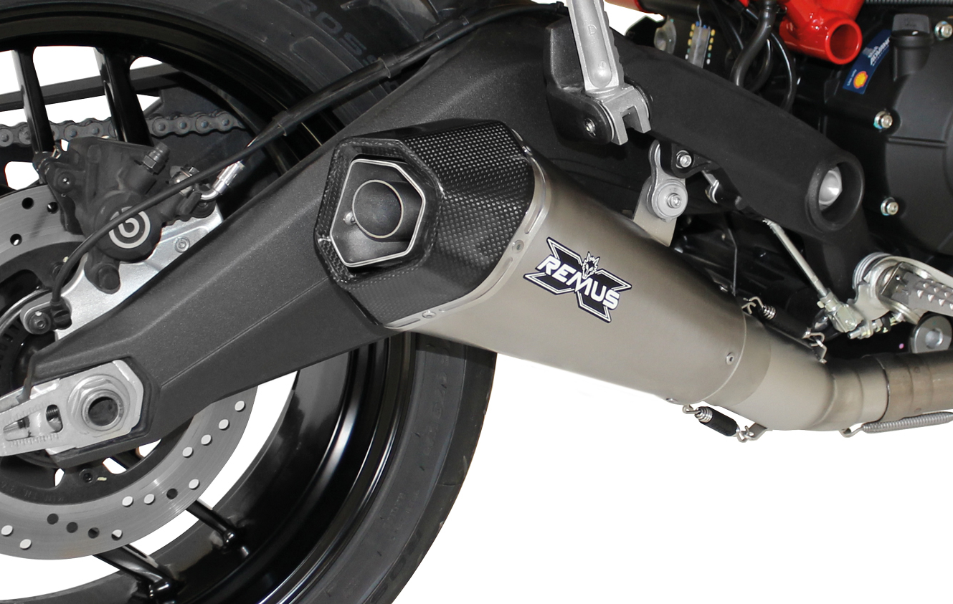
Weight (kg)
 |  |  | stock | REMUS
sleeve |  |  |  | stainless steel | titanium
front silencer |  |  | 6,40 | 1,90
silencer |  |  |  | 1,30 | 1,20
Abbildung kann vom Original abweichen / Picture can deviate from original product

Slide 3
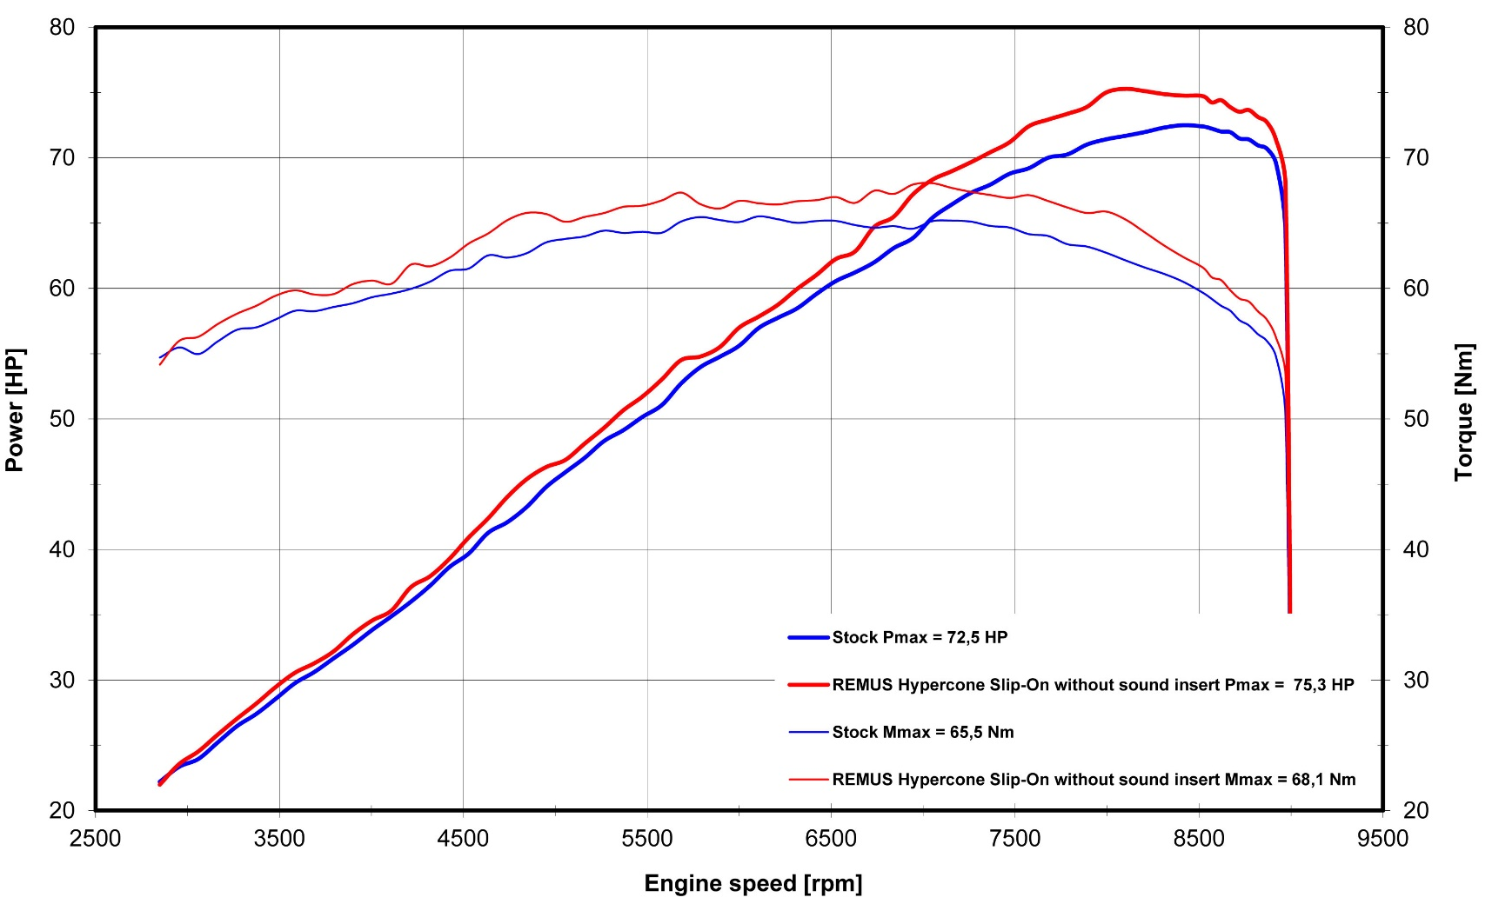
Dyno chart
Technische Änderungen und Irrtümer bleiben vorbehalten. Subject to technical alterations and errors.

Slide 4
Part numbers
PART NUMBERS IN DETAIL
Modell - type | Bj. year | Ømm | description | Typ type | sleeve version | Artikelnummer part number | EUR exkl. MwSt. EUR excl. VAT
Monster 797 | 17- | 65 | Stainless steel connecting tube no cat. | Race (no EG/ABE/EEC) |  | 0103 155217 | 101,00
MD, 54 kW |  |  | HYPERCONE with removable sound insert | Race (no EG/ABE/EEC) | stainless steel black | 6783 107365 | 387,00
 |  |  | HYPERCONE with removable sound insert | Race (no EG/ABE/EEC) | titanium | 6883 107365 | 457,00
Preise 2017 in Euro exkl. MwSt. / Prices 2017 in Euro excl. VAT! |  |  |  | Irrtum und Änderung vorbehalten / Errors and omission excepted
SET PART NUMBERS
Modell - type | Bj. year | Ømm | description | Typ type | Schalldämpfer muffler | sleeve version | Setartikelnummer setpartnumber | EUR exkl. MwSt. EUR excl. VAT
Monster 797 | 17- | 65 | RACING slip on sport exhaust system with removable sound insert | Race (no EG/ABE/EEC) | HYPERCONE | stainless steel black | 036783 155217 | 488,00
MD, 54 kW |  |  |  |  | HYPERCONE | titanium | 036883 155217 | 558,00
Preise 2017 in Euro exkl. MwSt. / Prices 2017 in Euro excl. VAT! |  |  |  |  | Irrtum und Änderung vorbehalten / Errors and omission excepted

