Slide 1
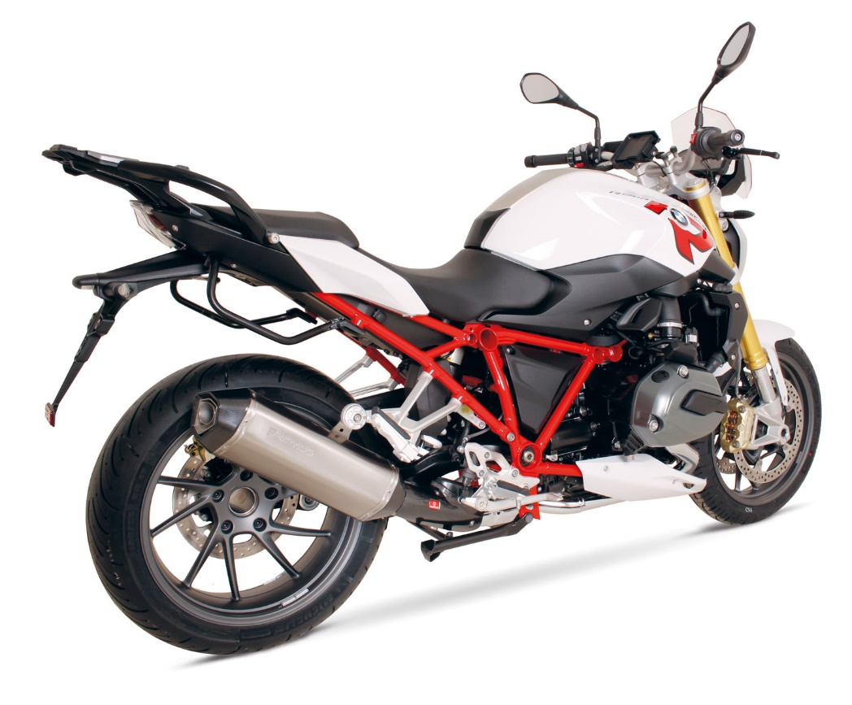
BIKE INFO 01/2015
BMW R1200R Mod. 2015

Slide 2
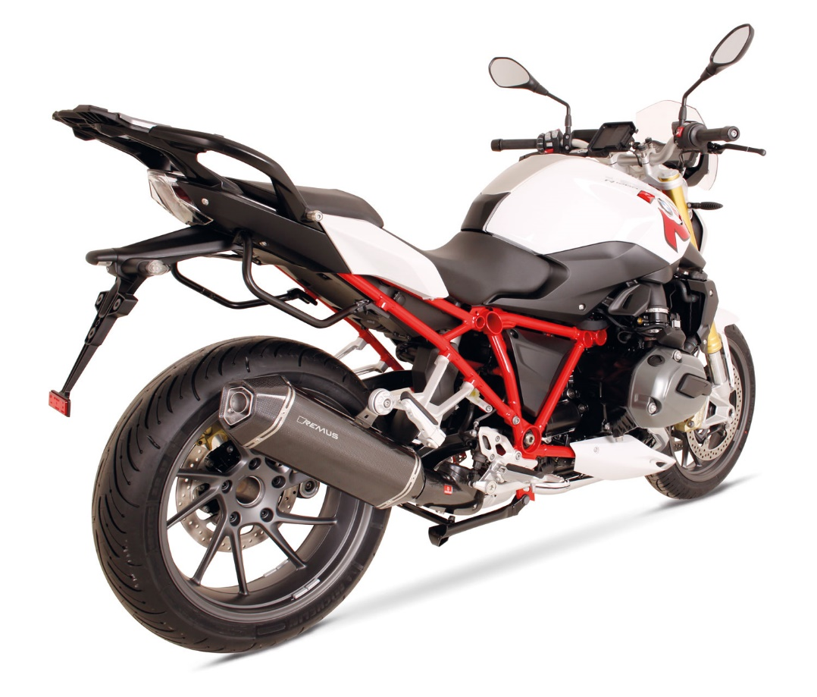
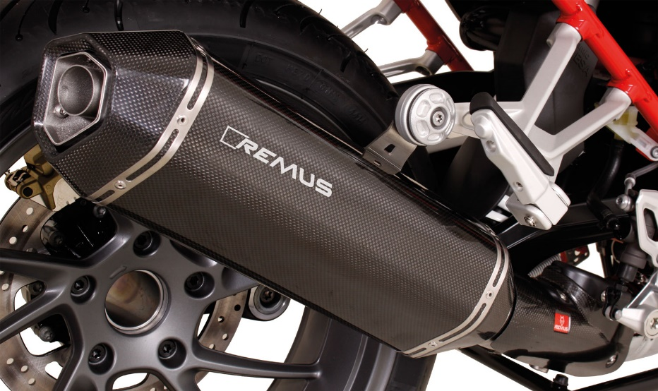
Motorrad / Bike
Slip-on Hexacone
Gewicht / weight (kg)
 |  |  | stock | REMUS
Außenmantel / sleeve |  |  |  | Edelstahl / stainless steel | Titan / titanium | Carbon
Verbindungsrohr / connecting tube |  |  | 4,40 | 0,40
Schalldämpfer / silencer |  |  |  | 2,60 | 2,50 | 2,40
Abbildung kann vom Original abweichen / Picture can deviate from original product

Slide 3
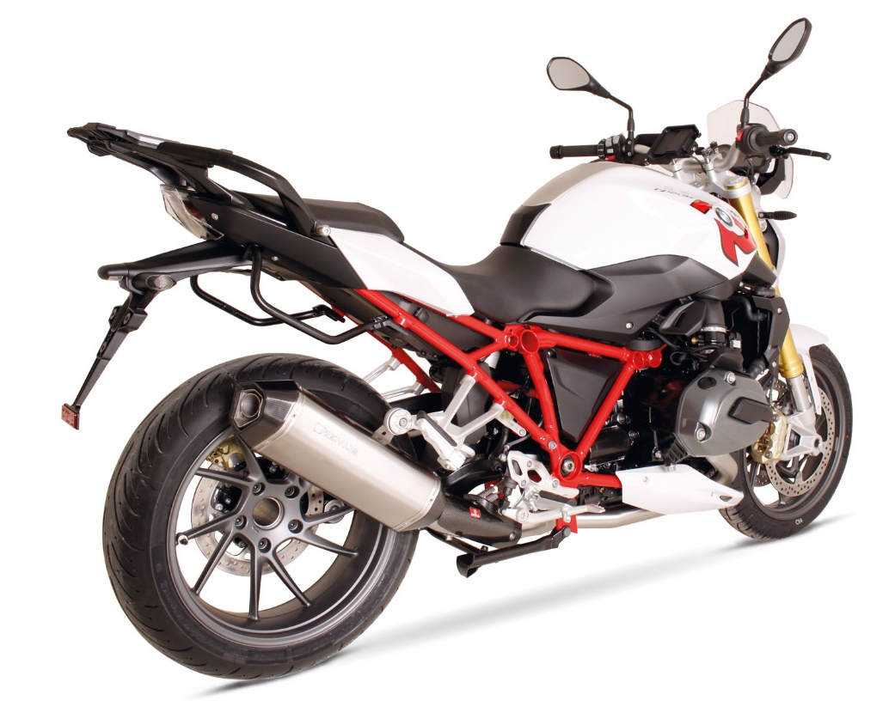
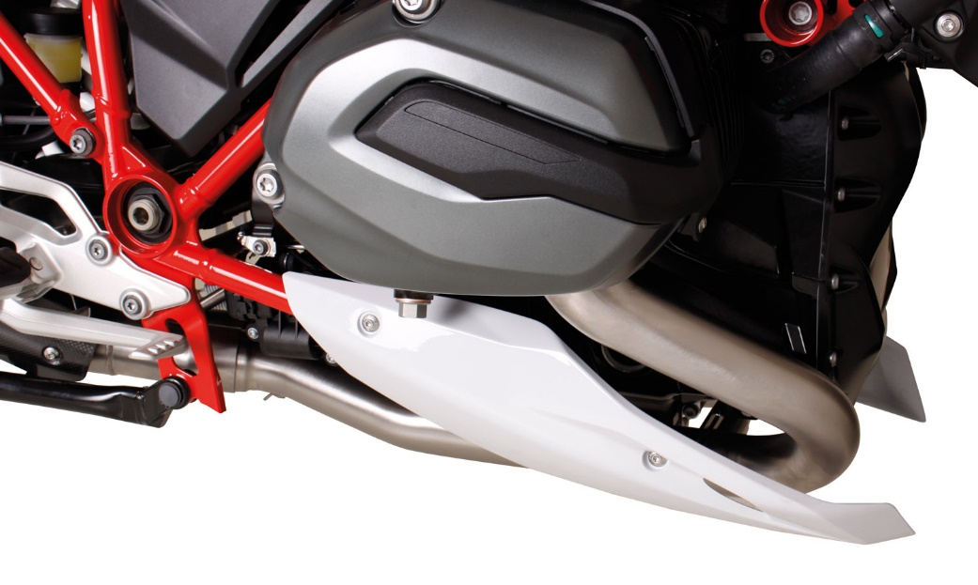
Motorrad / Bike
Komplettanlage / Complete system
Gewicht / weight (kg)
 |  |  | stock | REMUS
Außenmantel / sleeve |  |  |  | Edelstahl / stainless steel
Krümmer / header |  |  | 7,40 | 3,40
Abbildung kann vom Original abweichen / Picture can deviate from original product

Slide 4
Artikelliste im Detail / Partnumbers in detail
ARTIKELNUMMERN IM DETAIL / PART NUMBERS IN DETAIL
Modell - type | Bj. year | Ømm | Beschreibung | description | Typ | type | Mantel Variante | sleeve version | Artikelnummer part number | EUR exkl. MwSt. EUR excl. VAT
R 1200 R | 15- | 65 | Edelstahl - Krümmer (2-1) ohne Kat. inkl. Carbon Hitzeschutzabdeckung | stainless steel header (2-1) no cat. incl. carbon heat protecting shield |  |  |  |  | 0101 088015 | 729,00
92 kW |  |  | Edelstahl - Verbindungsrohr inkl. Carbon Hitzeschutzabdeckung | stainless steel connecting tube incl. Carbon heat protecting shield |  |  |  |  | 0105 088015 | 218,00
 |  |  | HEXACONE | HEXACONE | EG/ABE | EEC | Edelstahl | stainless steel | 4682 088015 | 381,00
 |  |  | HEXACONE | HEXACONE | EG/ABE | EEC | Carbon | carbon | 4482 088015 | 451,00
 |  |  | HEXACONE | HEXACONE | EG/ABE | EEC | Titan | titanium | 4882 088015 | 437,00
Preise 2015 in Euro exkl. MwSt. / Prices 2015 in Euro excl. VAT! |  |  |  |  |  |  |  | Irrtum und Änderung vorbehalten / Errors and omission excepted

Slide 5
Artikelliste / Partnumbers
ARTIKELNUMMERN / PART NUMBERS
Modell - type | Bj. year | Ømm | Beschreibung | description | Typ | type | Schalldämpfer | Mantel | sleeve | Setartikelnummer | EUR exkl. MwSt. EUR excl. VAT
 |  |  |  |  |  |  | muffler | Variante | version | setpartnumber
R 1200 R | 15- | 65 | Slip on (Schalldämpfer) inkl. | slip on (muffler) incl. CARBON | EG/ABE/EEC |  | HEXACONE | Edelstahl | stainless steel | 054682 088015 | 599,00
92 kW |  |  | CARBON Hitzeschutzabdeckung | heat protecting shield | EG/ABE/EEC |  | HEXACONE | Carbon | carbon | 054482 088015 | 669,00
 |  |  |  |  | EG/ABE/EEC |  | HEXACONE | Titan | titanium | 054882 088015 | 655,00
 |  |  | Komplettanlage (2-1) inkl. | complete system (2-1) incl. | Race (no EG/ABE/EEC) |  | HEXACONE | Edelstahl | stainless steel | 014682 088015 | 1.110,00
 |  |  | CARBON Hitzeschutzabdeckung | CARBON heat protecting shield | Race (no EG/ABE/EEC) |  | HEXACONE | Carbon | carbon | 014482 088015 | 1.180,00
 |  |  |  |  | Race (no EG/ABE/EEC) |  | HEXACONE | Titan | titanium | 014882 088015 | 1.166,00
Preise 2015 in Euro exkl. MwSt. / Prices 2015 in Euro excl. VAT! |  |  |  |  |  |  |  |  | Irrtum und Änderung vorbehalten / Errors and omission excepted

